Slide 1





Labor Considerations for Tennessee Farmers:
Strategies for Securing and Managing Agricultural Labor

Slide 2

Brief Introduction to Trends and Challenges in Agricultural Labor
Dr. Margarita Velandia, mvelandi@utk.edu, (865)974-7409, UT Extension

Slide 3
Background
Some farmers and agribusiness owners identify labor as one of the most important elements putting at risk the long-term sustainability of their farm businesses.
Labor-intensive farms and agribusinesses worry about labor, especially the ability to continue with their businesses as they get older, and they continue to struggle to find reliable workers.
Some farmers and agribusiness owners think about the future in a pessimistic way.

Slide 4
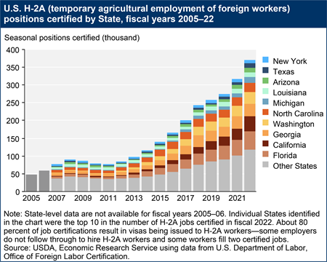
Labor Scarcity: Evidence from the H-2A Program Growth in the US

Slide 5
Farm Labor Scarcity in TN: H-2A Program in TN

Slide 6
Farm Labor Scarcity in TN

Slide 7
Labor Challenges Faced by TN F&V Growers

Slide 8
Labor Challenges Faced by TN Nursery and Green Industry

Slide 9
Strategies to Address Labor Challenges

Slide 10
Strategies to Address Labor Challenges

Slide 11
Introduction to Farm Labor Options for Agricultural Employers and Agribusinesses in Tennessee
Dr. Margarita Velandia, mvelandi@utk.edu, (865)974-7409, UT Extension

Slide 12
Options
TN NAFTA or USMCA Professionals Visa Program
Farm Labor Contractors/H-2ALC’s
H-2A Visa Program
Internships as a source of labor?
H-2B Visa Program

Slide 13
TN NAFTA or USMCA Professional Visa Program
The TN nonimmigrant classification permits qualified Canadian and Mexican citizens to seek temporary entry into the United States to engage in business activities at a professional level (e.g., accounts, agronomists, animal scientists, horticulturists, soil scientists, veterinarians, animal breeders).
High-skill workers: Require BS or “Licenciatura” degree.
Numbers are not capped.
No need to recruit US workers for the jobs advertised.
No cost to the employer in theory. In practice, recruitment, offering transportation and housing at low cost, and reimbursement of expenses while traveling might help attract the right workers.

Slide 14
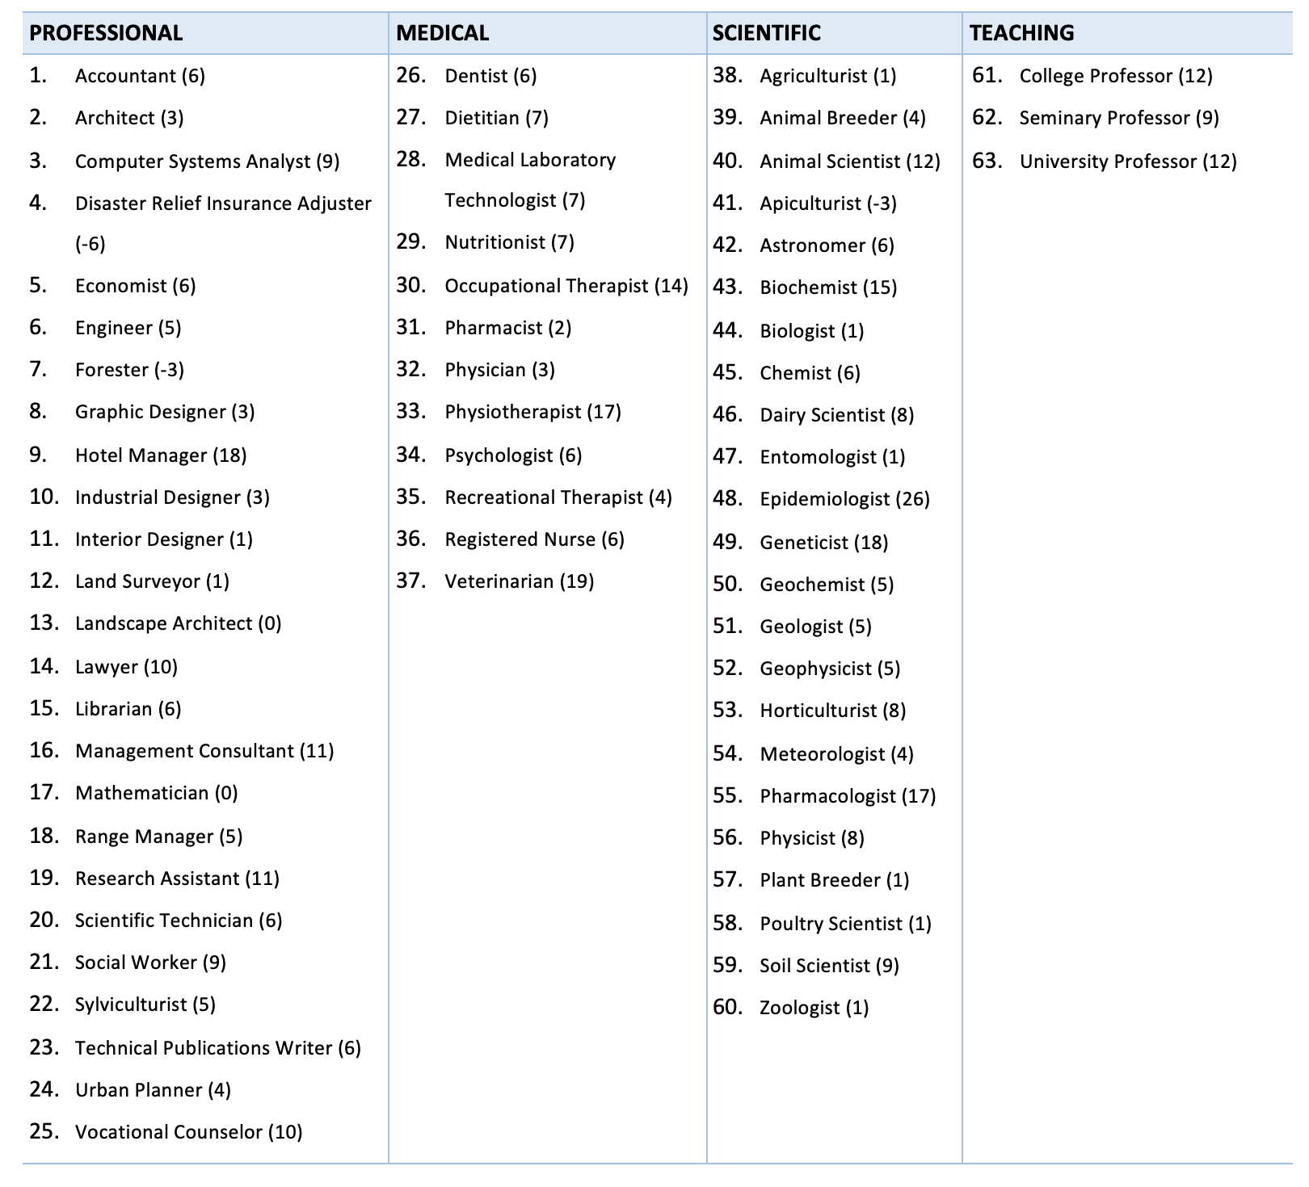
TN Program: Professions and Employment Projection Change

Slide 15
TN Program: Admissions and Visas Issued in the US

Slide 16



Farm Labor Contractors (FLC)
A FLC is someone who receives compensation in return for providing any of the following services to migrant and/or seasonal agriculture workers:
  Furnishing – providing workers as needed or wanted
  Recruiting – the process of attracting or selecting someone for a job
  Employing – giving work to someone
  Soliciting – asking for or trying to obtain someone to work
  Hiring – employing someone to work for wages
  Transporting – driving workers to and from the field
  Housing – facility must comply with federal and state safety and health standards
Farmer/Grower
FLC/H-2ALC
Workers

Slide 17
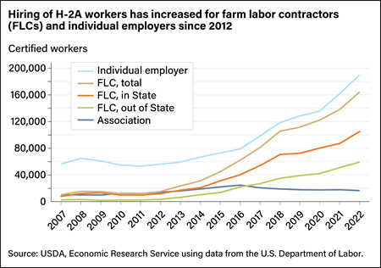

Slide 18
H-2B Program
Permits employers to temporarily hire nonimmigrants to perform nonagricultural labor or services in the United States.
Employment must be of a temporary nature, full-time (at least 35 hours per week) for a limited period, such as a one-time occurrence, seasonal need, peak load need, or intermittent need. Cannot become permanent positions.
There are minimum wage requirements to be paid to workers to avoid negatively affecting the local job market.
The program has a congressional cap (October 1=33,000, April 1= 33,000, Annual total 66,000). An increase in additional visas was approved in 2022 by DOL.

Slide 19
H-2B Program in TN
Costs: Visa-related expenses, transportation expenses to the worksite and back to home country, stipend to cover food and lodging while traveling, recruitment activities, and probably an attorney/agent (e.g., lawyer) fee to handle paperwork, workers’ compensation.
Housing and daily transportation: The employer is not required to provide housing under this program.

Slide 20
H-2B Program in TN FY2022
SOC | SOC_TITLE | No. Certified Workers | Min Wage | Max Wage
37-3011 | Landscaping and Groundskeeping Workers | 1127 | $14.24 | $15.29
47-2061 | Construction Laborers | 295 | $16.54 | $18.52
37-2012 | Maids and Housekeeping Cleaners | 180 | $11.95 | $14.78
43-5081 | Stock Clerks and Order Fillers | 147 | $12.58 | $12.58
39-3091 | Amusement and Recreation Attendants | 119 | $10.87 | $12.85
35-3022 | Counter Attendants, Cafeteria, Food Concession, and Coffee Shop | 100 | $10.59 | NA
53-7064 | Packers and Packagers, Hand | 75 | $12.42 | $12.42
47-2051 | Cement Masons and Concrete Finishers | 73 | $17.43 | $18.94
51-3023 | Slaughterers and Meat Packers | 56 | $13.74 | NA
37-2011 | Janitors and Cleaners, Except Maids and Housekeeping Cleaners | 54 | $12.43 | $13.23

Slide 21
H-2A Program
(Immigration and Nationality Act: INA)
Allows U.S. agricultural employers experiencing a shortage of domestic workers to fill seasonal or temporary jobs with foreign nonimmigrant workers.
The employment has to be seasonal or temporary in nature, implying that the work is tied to a specific time of the year when required labor is above the regular operation needs.
An employer seeking to employ H-2A workers is required to pay a wage at least equal to the AEWR if this is the highest applicable rate for the job offer by the employer.
Must guarantee to offer each covered worker employment for a total number of hours equal to at least 75% of the workdays in the contract period.
Employers must provide housing at no cost to H-2A workers. Provide workers with three meals per day, or to furnish free and convenient cooking and kitchen facilities.
Provide daily transportation at no cost.
Reimburse for inbound and outbound travel expenses.
Keep records and comply with regulations.

Slide 22
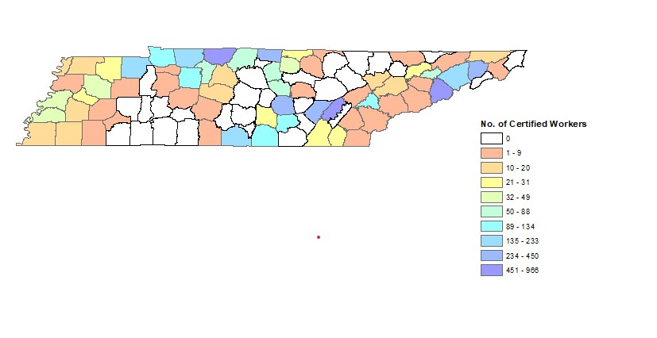
H-2A Program in TN

Slide 23
Who Can Help with the H-2A Program Certification Process in TN
Law firm/Business | E-mail or Website | Phone Number | Certified Workers
Agriculture Workforce Management Association | h2a@awmalabor.com | (859) 233-7845 | 1,840
National Agricultural Consultants LLC | theresa@nach2a.com | (910) 947-6004 | 1,094
AgWorks H2, LLC | https://www.maslabor.com/agworks | (434) 263-4300 | 822
Low Country Labor Company | ck@lowcountrylabor.com, https://lowcountrylabor.com/ | (843) 200-4263 | 697
Andrew Jackson Law P.C. | https://legalfarmworkersh2avisas.com/ | (910) 592-4124 | 250
Signature Staffing Inc. | stephanie@signaturestaffinginc.com | (863) 201-9211 | 167
Mas Labor H2A, LLC (They merged with AgWorks H2, LLC in 2022) | https://www.maslabor.com/agworks | (434) 263-4300 | 152
Florida Fruit and Vegetable Association | h2.labor@ffva.com |  | 144
KY FARMERS AID INC | kfainc2@gmail.com | (270) 489-2378 | 121
YOUNGBLOOD & ASSOCIATES, PLLC | H2@YOUNGBLOODASSOCIATES.COM | (931) 274-7811 | 114

Slide 24

H-2A Program Costs
DR. MARGARITA VELANDIA, MVELANDI@UTK.EDU, (865)974-7409, UT EXTENSION

Slide 25
Expense | Description | Example of Estimated Costs for four H-2A workers
H-2A labor certification filing fee (to DOL) | $100 per application plus $10 per certified worker (max of $1,000 total). One application will be $100 plus $40 ($10/worker x 4 workers) | $140
Non-immigrant worker petition filing fee (to USCIS) | $460 per application | $460
H-2A visa application consulate fee | $205 per worker. Must be reimbursed to the worker in the first paycheck. For a four-worker application, this will be $820. | $820
US border stamp fee | $6 per worker, for a total of $24 ($6/worker x 4 workers) | $24
Agent fee | Varies by the agent. For example, the agent’s fee for four workers could be between $400 and $600 per worker. This cost might decrease depending on the number of workers certified. The estimated cost for four workers in this example is $2,400 ($600/worker x 4 workers). | $2,400
Transportation country-worksite-country (e.g., transportation, lodging and per-diem) | Cost varies depending on the country of origin. In this example, we estimated $1,200/worker x 4 workers = $4,800 | $4,800
Weekly travel to and from the grocery store, bank and/or worksite | Cost varies. A farmer we interviewed suggested $0.4 to $0.5 per mile for town, bank, farm trips, etc. Because these costs would vary greatly depending on the farm location, distance to the worksite, grocery store, and bank, we did not estimate this cost, but it needs to be considered by employers of H-2A workers. | Varies greatly but needs to be included in total costs.
Workers Compensation | Required to have in order to employ H2A workers. The rates vary greatly depending on the type of work and crop the workers are working with. In this example, we estimated this cost to be $2,900 based on information from a grower using the H-2A program in TN. | $2,900
Housing and other living expenses | Varies by type of housing provided by employer. Examples of types of housing include mobile homes and apartment-style housing. Some employers subcontract housing with hotels or motels. | Varies greatly but needs to be included in total costs.

Slide 26
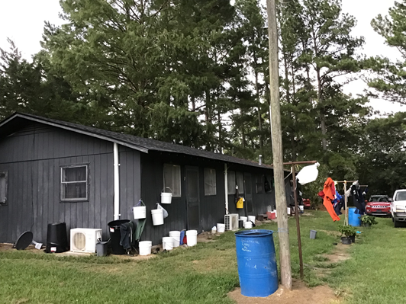
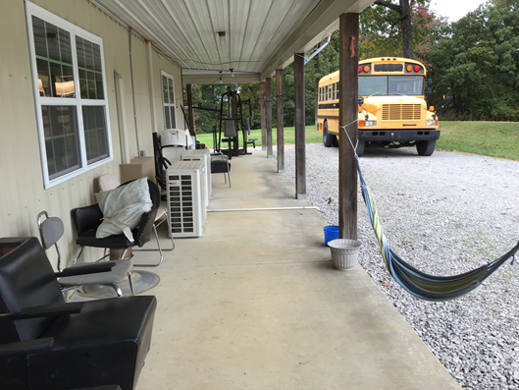
Housing
In Tennessee, the type of housing provided by employers to H-2A workers varies greatly depending on the number of workers. Examples of housing types used in Tennessee for H-2A workers include mobile homes, wood frame bunkhouses, trailers, metal frame houses, single-family houses, hotels, motels, and apartments.

Slide 27
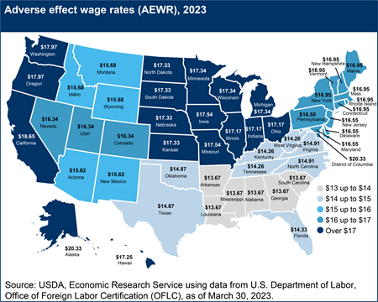
H-2A Costs: AEWR

Slide 28
H-2A Program 2023 AEWR Final Rule
The U.S. Department of Labor published a final rule in February of 2023 describing a new methodology for determining AEWR that was implemented on March 30, 2023, for certain occupations for temporary labor certification in the H-2A program.
Who is affected?
  Those employing workers outside of the following job categories:
    45-2041 -Graders and Sorters, Agricultural Products;
    45-2091 - Agricultural Equipment Operators;
    45- 2092 - Farmworkers and Laborers, Crop, Nursery, and Greenhouse;
    45-2093 - Farmworkers, Farm, Ranch, and Aquacultural Animals;
    53-7064 - Packers and Packagers, Hand; and
    45-2099 - Agricultural Workers, All Other.
  Examples: SOC code 45-1011 (First-Line Supervisors of Farm Workers) and jobs that entailed driving duties depending on the type of equipment involved and the location of the work.
Rule application will depend on depend on how the job order is structured and, on the job performed by the worker.
More information can be found at: 2023 H-2A Adverse Effect Wage Rate (AEWR) Final Rule FAQs tiny.utk.edu/LF59v

Slide 29

Option for Smaller Operations

Slide 30
Option for Small Operations
Smaller operations may not have the need for full-time H-2A workers.
The formation of a legal entity (LLC, Partnership, etc.) might provide the benefit of sharing workers with other operations.
Considerations:
  Housing
  Hours worked
  Paperwork
  Peak demand
If you want to consider this option, discuss with legal counsel who has experience with the H-2A program.

Slide 31
Internships as a source of labor (https://extension.tennessee.edu/publications/Documents/W942.pdf)
An internship is a form of experiential learning, where a student has the opportunity to gain experience that can assist the student in his or her career.
The distinction between an internship and employment is important as employer-employee relationships are governed by the Fair Labor Standards Act (FLSA), while internships are not.

Slide 32
When Is an Individual Considered an Intern and Not an Employee?
The “primary beneficiary test”:
Understanding that there is no expectation of compensation.
Internship offers an educational environment similar to the one provided in an educational institution.
Integration between the internship and the intern's formal education program through integration of coursework or the receipt of academic credit.
The accommodation of the internship to the intern's academic commitments.
The duration of the internship is tailored to the period of time in which the internship provides the intern with beneficial learning.
The work performed by interns complements rather than displaces the work of paid employees.
Interns understand they are not entitled to a job at the conclusion of the training period.

Slide 33


Other Things to Consider When Employing Interns
oKeep records of the training curriculum;
oKeep records of the hours worked and tasks performed by interns;
oFile all required reports and paperwork with any institutions providing course credit for the internship;
oHave the intern sign an agreement prior to the start of the internship acknowledging they are a non-employee intern and specifying the amount of wages, if any, they are to receive; and
oGet insurance that will cover potential injuries on the farm.

Slide 34
Agricultural Labor Laws
U.S. Department of Labor
Wage and Hour Division

Slide 35
Agricultural Employer Compliance Responsibilities
Fair Labor Standards Act
Migrant & Seasonal Agricultural Worker Protection Act
Field Sanitation

Slide 36
Fair Labor Standards Act
(FLSA)

Slide 37
Agriculture
Includes farming in all its branches and among other things includes the cultivation and tillage of the soil, dairying, the production, cultivation, growing, and harvesting of any agricultural or horticultural commodities.

Slide 38
FLSA Coverage
Two Types of Coverage
  Enterprise Coverage: If an enterprise is covered, all employees (unless specifically exempt) of the enterprise are entitled to FLSA protections.
  Individual Coverage: Even if the enterprise is not covered, individual employees may be covered and entitled to FLSA protections.

Slide 39
Enterprise Coverage
Enterprise with:
  At least two (2) employees handling goods that have moved in interstate commerce
  At least $500,000 a year in gross receipts
If these two conditions are met, then all employees are covered

Slide 40
Individual Coverage
Workers who are engaged in:
  Interstate commerce;
  Production of goods for commerce;
  Closely-related process or occupation directly essential to such production
Essentially all field workers are individually covered by FLSA

Slide 41
FLSA Minimum Wage
Minimum wage of $7.25 per hour must be paid regardless of method of payment:
  hourly
  piece rate
  job rate
  day rate
  salary

Slide 42
FLSA Overtime to be Paid
Time and one-half after forty hours must be paid in these cases:
  Certain packing/processing plants where goods are processed for more than one farmer
  Retail operations off the farm, for example nursery outlets
  Reforestation and Christmas trees

Slide 43
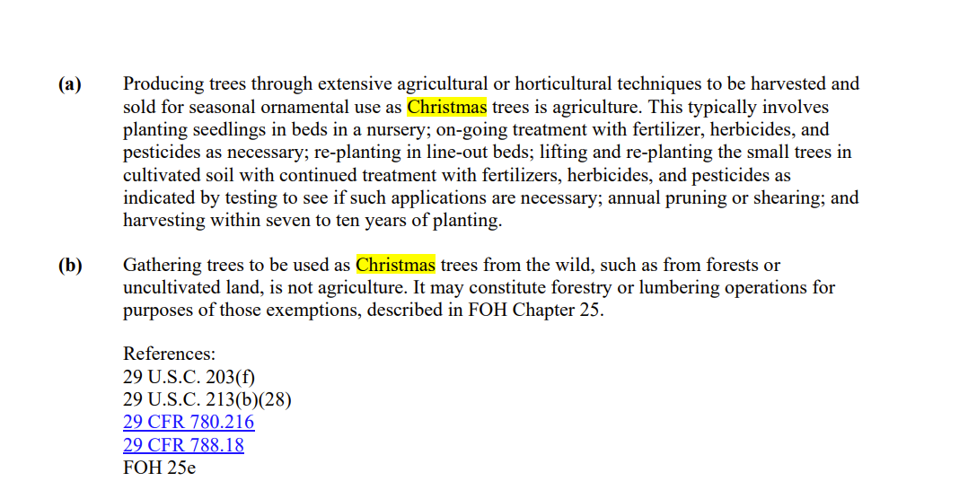

Slide 44
FLSA Overtime Exemption
Workers employed solely in agriculture need NOT be paid overtime
Examples:
  Field workers
  Tractor operators
  Loaders and drivers
  Farm office personnel

Slide 45
FLSA Record Keeping
Records for each employee
  Name, address and social security number
  Date of birth for anyone under age 19
  Hours worked per day and week
  Rate of pay
  Gross wages
  All deductions

Slide 46
Compliance Assistance Materials
Fair Labor Standards Act
29 C.F.R. Part 780
Fact Sheet No. 012 Agricultural Employers Under The Fair Labor Standards Act (FLSA)
Fact Sheet No. 040 Federal Child Labor Laws in Farm Jobs

Slide 47
The Migrant & Seasonal Agricultural Workers Protection Act (MSPA)

Slide 48
MSPA Overview
Coverage
Joint Employment
Registration
Disclosure
Records
Wages
Safe Transportation
Safe Housing
Exemptions

Slide 49
MSPA Coverage
MSPA applies to:
  Farm Labor Contractors (FLC)
  Agricultural Employers (AGER)
  Agricultural Associations (AGAS)
  Housing Providers (HP)

Slide 50
MSPA Coverage - AGERs, and AGAS’
AGERs, and AGAS’ are subject to MSPA if they:
  Furnish
  Recruit
  Employ
  Solicit
  Hire
  Transport

Slide 51
MSPA Coverage - FLCs
FLCs are subject to MSPA if they, for a fee or other consideration:
  Furnish
  Recruit
  Employ
  Solicit
  Hire
  Transport

Slide 52
MSPA Agricultural Workers
Migrant Agricultural Worker
  Required to be away overnight from permanent residence
Seasonal Agricultural Worker
  Not required to stay overnight away from permanent residence (local resident).

Slide 53
Joint Employment under MSPA
Employment of an individual by two or more employers (including AGERs, AGAS, & FLCs) who simultaneously benefit from the work of the employee.
All joint employers are responsible for assuring workers are employed in compliance with all applicable laws, including MSPA.

Slide 54
Who Must Register
  Farm Labor Contractors (FLCs) and Farm Labor Contractor Employees (FLCE)
    if they furnish, recruit, employ, solicit, hire, or transport for a fee or other valuable consideration
    prior to performing work
  AGERs, AGAS’ and employees of AGERs and AGAS’ need not register

Slide 55
Registration Process
Applicant must submit an Application for Farm Labor Contractor or Farm Labor Contractor Employee Certificate of Registration (Form WH-530).
There is no cost to applicant.
Additional information is required before authorization will be issued for Driving, Housing, or Transporting.

Slide 56
Proof of Registration
FLC / FLCE must carry the registration card at all times
FLC / FLCE must present the card upon request
All persons using the services of an FLC must ensure valid registration

Slide 57
Items to be Disclosed
Rates of pay and other benefits
Period of employment
Place of employment
Crops
Worker’s compensation
Transportation arrangements
Housing conditions

Slide 58
Wage Requirements
Employers must:
  Pay the rate disclosed, promised or contracted
  Pay not less than minimum wage
  Pay at least semi-monthly
  Deposit and report taxes withheld

Slide 59
Deductions from Wages
Employers may not take deductions:
  Unless they are disclosed in writing to the workers
  If the charges create a profit for the employer (even if disclosed in writing)
  For cigarettes or alcohol (unless the employer is licensed to sell these)

Slide 60
MSPA Transportation
When agricultural workers are transported, MSPA requires:
  Safe and properly insured vehicles
  Authorization to transport for FLC
  Authorization to drive for FLC/FLCE
  Separate authorization for driving and transporting

Slide 61
Common Problems
No fixed seats on vehicles
Insufficient insurance
Improper or no license for driver
Vehicle safety problems - broken windshield, brake lights not working, bald tires, etc.
Overloaded vehicle

Slide 62
Housing Safety & Health
MSPA housing standards only apply to migrant agricultural workers
AGERs, FLCs, and AGAS’ and housing providers are responsible for housing safety and health when they own or control the property

Slide 63
Compliance Assistance Materials
Migrant and Seasonal Agricultural Workers Protection Act
29 C.F.R. Part 500
Fact Sheet No. 035 Joint Employment and Independent Contractors Under the Migrant and Seasonal Agricultural Worker Protection Act
Fact Sheet 040 Federal Child Labor Laws in Farm Jobs

Slide 64
H-2A Visa Program
  Lance Butler, TN Department of Labor & Workforce Development
  Jane Chadwell, GAP Connections

Slide 65
H2A Visa Program
What's needed to petition for visa statues

Slide 66
Scope
We will discuss what is the H2A visa program and what is needed to petition for visa statues.

Slide 67
What is an H2A visa
The H-2A program allows U.S. employers or U.S. agents who meet specific regulatory requirements to bring foreign nationals to the United States to fill temporary agricultural jobs.

Slide 68
How to apply
Step one: Filing a Job Order for an H2A opportunity
Employers and their authorized attorneys or agents must submit H-2A job orders (i.e., H-2A Agricultural Clearance Order Form ETA-790/790A) and all required addenda using the electronic method.
The department's electronic filing platform is Foreign Labor Application Gateway (FLAG), available at https://flag.dol.gov.
Upon receipt of the job order, the National Processing Center (NPC) will transmit an electronic copy of the job order to the State Workforce Agency (SWA) serving the area of intended employment for intrastate clearance.
The Job order must be file 75-60 days before the employer’s date of need.

Slide 69
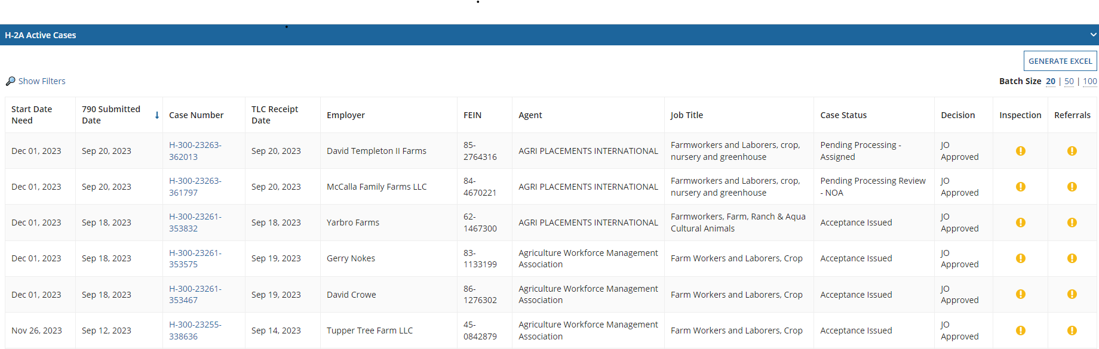
FLAG

Slide 70
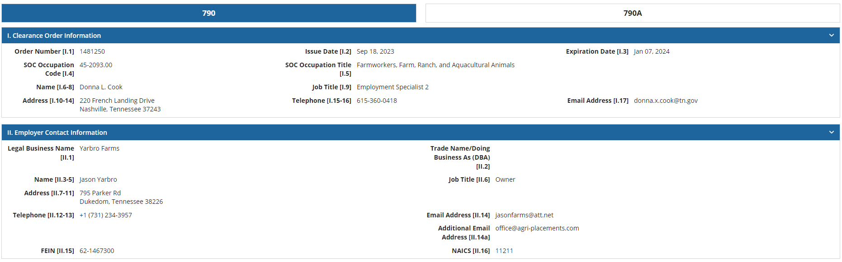
FLAG
Example of 790:

Slide 71
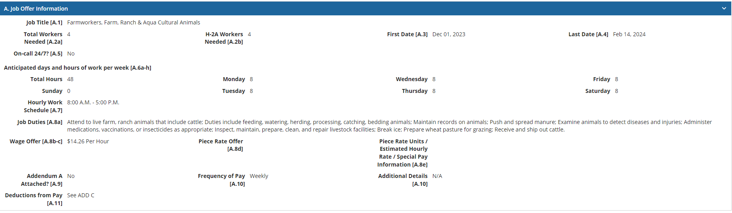
FLAG
Example of 790A: Job Offer/Order

Slide 72
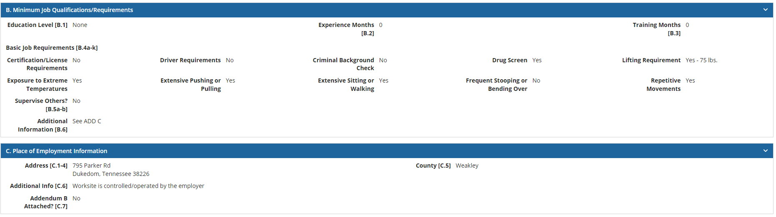
FLAG
Example of 790A: Minimum Job Qualifications and Requirements

Slide 73
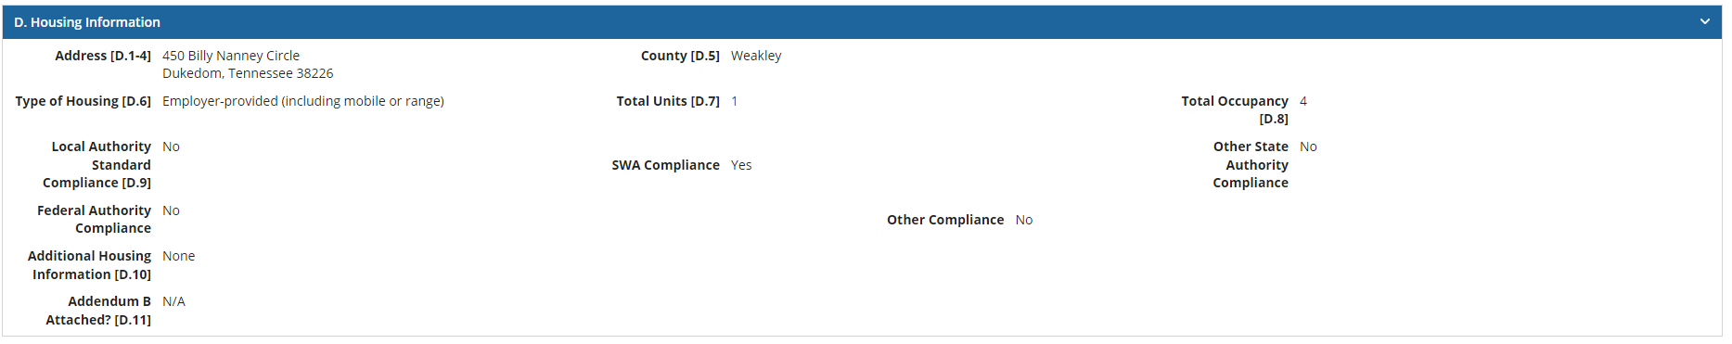
FLAG
Example of 790A: Housing information

Slide 74
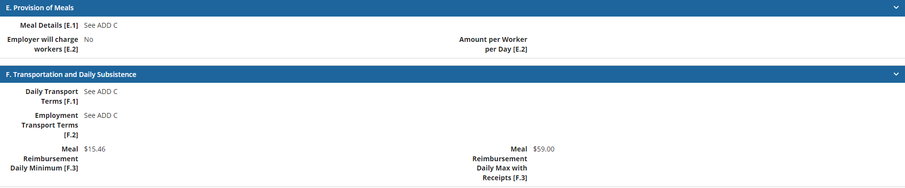
FLAG
Example of 790A: Provisions and Transportation

Slide 75
FLAG
Example of 790A: Referral & Hiring Instructions

Slide 76
How to apply
Step 2: Filing an H-2A Application for Temporary Employment Certification (Form ETA-9142A) and All Required Appendices and Documentation with the NPC.
Submit an H-2A Application for Temporary Employment Certification (Form ETA-9142A) and all required documentation with the NPC electronically using the FLAG system, unless a specific exemption applies.
The NPC will review the application and job order for compliance and let the employer know of any deficiencies in seven days.
In joint-employer situations, the H-2A Application for Temporary Employment Certification must be signed and dated by each joint employer named in in the application.
The application should be filed no less than 45 calendar days before the employer's first date of need.

Slide 77
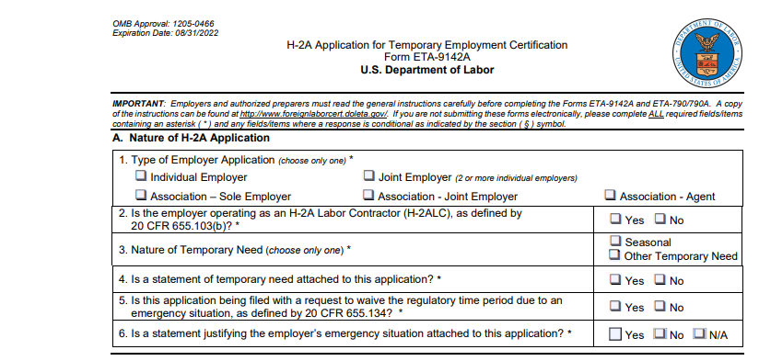
ETA 9124A Form

Slide 78
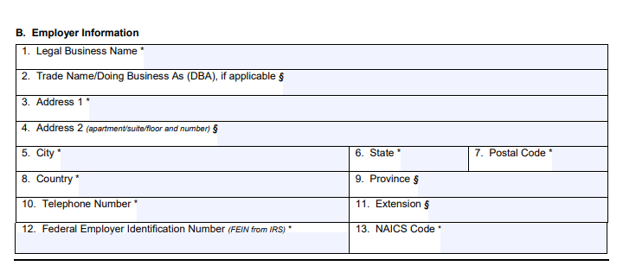
ETA 9124A Form

Slide 79
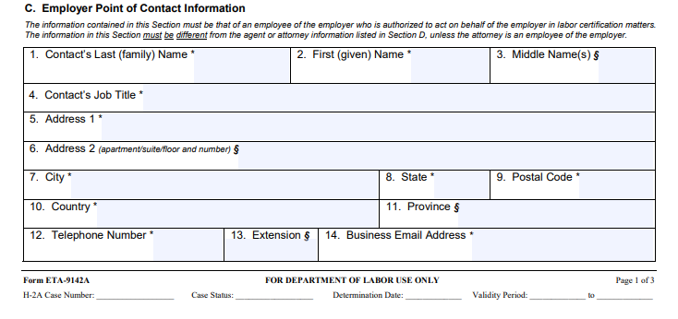
ETA 9124A Form

Slide 80
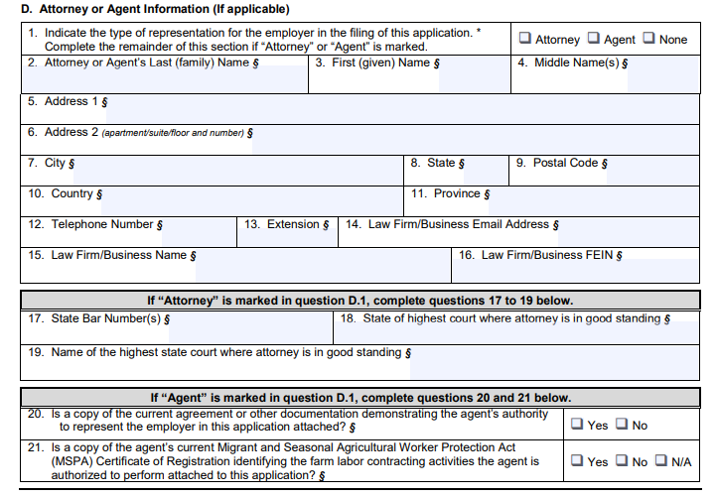
ETA 9124A Form

Slide 81
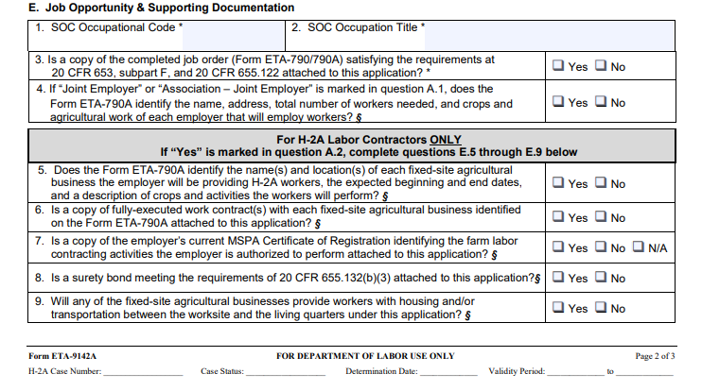
ETA 9124A Form

Slide 82
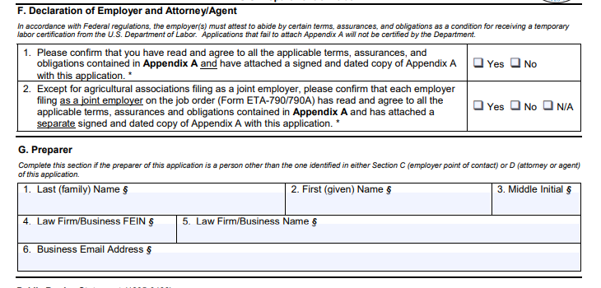
ETA 9124A Form

Slide 83
How to apply
Step 3: Conducting Recruitment for U.S. Workers
The employer must engage in positive recruitment of U.S. workers.
Once the CO determines that the H-2A Application for Temporary Employment Certification and the job order meet requirements such that recruitment may begin, the CO will notify the employer of acceptance of the application and will send a copy of the notice to the SWA serving the area of intended employment.
The CO will promptly transmit a copy of the approved job order for interstate clearance, at a minimum to all States listed in the job order as anticipated place(s) of employment.
In addition, the CO will promptly place for public examination a copy of the job order on an electronic job registry maintained by the Department of Labor, which is accessible via SeasonalJobs.dol.gov.
Furthermore, the SWA will post a copy of the job order on their Agricultural Recruitment System (ARS) for positive recruitment.

Slide 84
How to apply
Step 3: Conducting Recruitment for U.S. Workers(Continued)
In the state of Tennessee our ARS website is Jobs4tn.gov.
If applicants appear on the recruitment report, the employer must contact, by mail or other effective means, U.S. workers employed by the employer in the occupation at the place of employment during the previous year and solicit their return to the job. This contact must occur during the period that the job order is being circulated by the SWA(s) for interstate clearance.

Slide 85
How to apply
Step 4: Completing the Temporary Labor Certification Process
If temporary agricultural labor certification is granted, the CO will send a Final Determination notice, the Approval Appendix and an invoice to all available emails identified in the application.
Temporary Labor Certifications are generally issued no later than 30 calendar days before the first date of need identified in the Application for Temporary Employment Certification.

Slide 86
Thank You
Lance Butler: Lance.Butler@tn.gov
Office Phone: 615-741-5671
Cell: 629-867-9230

Slide 87
Farm Labor Contractors (FLC’s & H-2ALC’s)
Jane Chadwell
GAP Connections

Slide 88
Farm Labor Contractors (FLC)
A FLC is someone who receives compensation in return for providing any of the following services to migrant and/or seasonal agriculture workers:
  Furnishing – providing workers as needed or wanted
  Recruiting – the process of attracting or selecting someone for a job
  Employing – giving work to someone
  Soliciting – asking for or trying to obtain someone to work
  Hiring – employing someone to work for wages
  Transporting – driving workers to and from the field
  Housing – facility must comply with federal and state safety and health standards
Farmer/Grower
FLC/H-2ALC
Workers

Slide 89
Q and A
A grower uses a crew leader to provide his labor. Is that the same as a Farm Labor Contractor (FLC)?
No matter the term used “crew leader”, “crew boss”, “supervisor”, etc. If the person hires, solicits, recruits, or transports any worker on behalf of the grower for a fee they are considered a Farm Labor Contractor (FLC).
Note: Employees of a grower do not have to register to do the activities described above. If a grower has a year-round employee and that employee goes out recruiting people, the employee does not need to register as an FLC.

Slide 90
Farm Labor Contractor (FLC)
H-2ALC
VS
Non-H-2A Labor (migrant or local labor)
H-2A Labor

Slide 91

WH1021English.pdf (dol.gov)

Slide 92
License
MUST:
Be registered (current and not on debarred list)
Keep their FLC card on them at all times
Be authorized for all services being provided
Housing
  Current pre-occupancy housing inspection certificate for each facility
Transportation
  All vehicles used are included on FLC certification card
  All vehicles used have current tags and inspections
  Insurances (auto & workers comp) for each vehicle
Driving
  Have doctor’s certification
  Have a valid drivers license
  Certification to drive

Slide 93
H-2ALCs
H-2ALCs must:
  Have a contract with grower/farmer AND
  Obtain a surety bond that covers liability incurred during the term of the work contract period listed on the H-2A application and must remain in effect for a period of at least 2 years from the expiration date of the labor certification

Slide 94
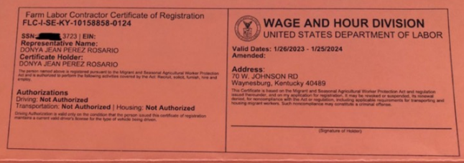
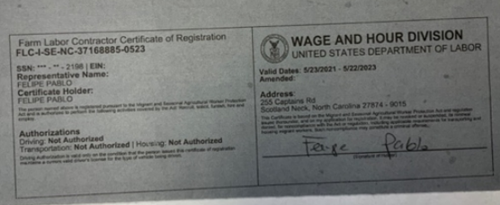

Slide 95
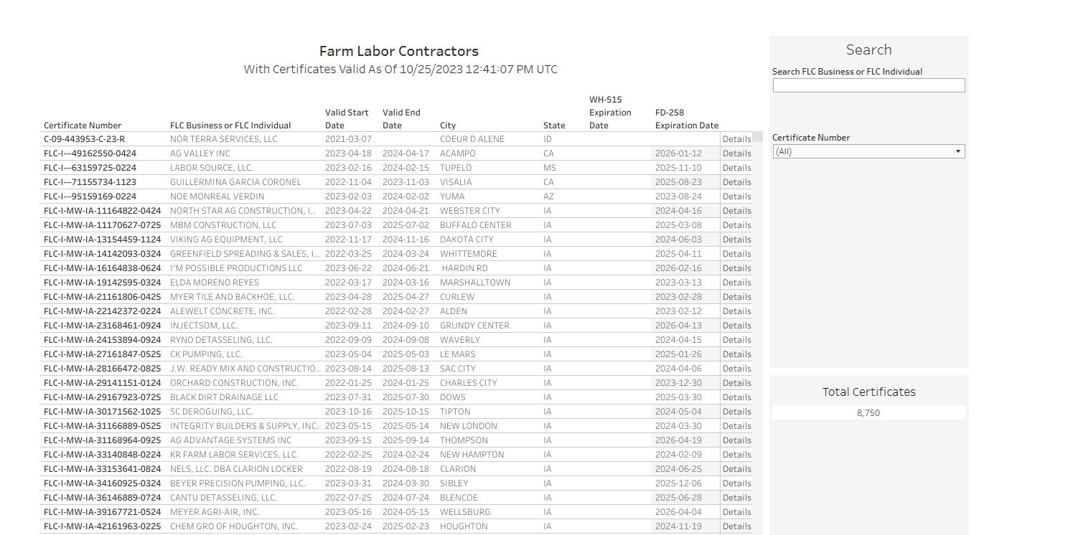
Look them up...
Migrant and Seasonal Agricultural Worker Protection Act (MSPA) Registered Farm Labor Contractor Listing | U.S. Department of Labor (dol.gov)
https://www.dol.gov/agencies/whd/agriculture/mspa/farm-labor-contractors

Slide 96
Look them up...

Slide 97
Tennessee
Certificate Number | FLC Business or FLC Individual | Valid Start Date | Valid End Date | City | ST | Business Type | City | Driving Authority | Housing | ST | Transportation
FLC-I-SE-TN-13137672-1123 | CUMBERLAND FORESTRY CONTRACTORS, LLC | 12/2/2021 | 12/1/2023 | CHATTANOOGA | TN | LLC | Chattanooga | N | N | TN | Y
FLC-I-SE-TN-22162157-0424 | ALVIN GONZALEZ DURAN | 4/6/2023 | 4/5/2024 | NASHVILLE | TN | Individual | NASHVILLE | Y | N | TN | N
FLC-I-SE-TN-26139504-0224 | JENNIFER ANN RANGEL | 2/17/2022 | 2/16/2024 | ANTIOCH | TN | Individual | Antioch | N | N | TN | N
FLC-I-SE-TN-27157484-0124 | MARTIN AVALOS-SALAZAR | 1/5/2023 | 1/4/2024 | DAYTON | TN | Individual | Dayton | Y | N | TN | N
FLC-I-SE-TN-32166559-0525 | JOSE JOAQUIN PEREZ | 5/9/2023 | 5/8/2025 | COLUMBIA | TN | Individual | Columbia | Y | N | TN | Y
FLC-I-SE-TN-38168617-0725 | MITCHELL EDWARD PRESSON DBA TIMBERLAND FORESTRY SERVICE | 8/2/2023 | 8/1/2025 | HIXSON | TN | Other | HIXSON | Y | N | TN | Y
FLC-I-SE-TN-54146477-0824 | SEASONAL HARVESTERS LLC | 8/15/2022 | 8/14/2024 | FAYETTEVILLE | TN | LLC | Fayetteville | N | N | TN | N
FLC-I-SE-TN-56136731-1123 | SPRINGFIELD AG SERVICE LLC | 11/23/2021 | 11/22/2023 | JACKSON | TN | Corporation | Jackson | N | N | TN | Y
FLC-I-SE-TN-90162148-0724 | NESTOR MONTIEL ARAGON | 7/11/2023 | 7/10/2024 | NASHVILLE | TN | Individual | Nashville | Y | N | TN | N

Slide 98

Considerations when Working with a FLC

Slide 99
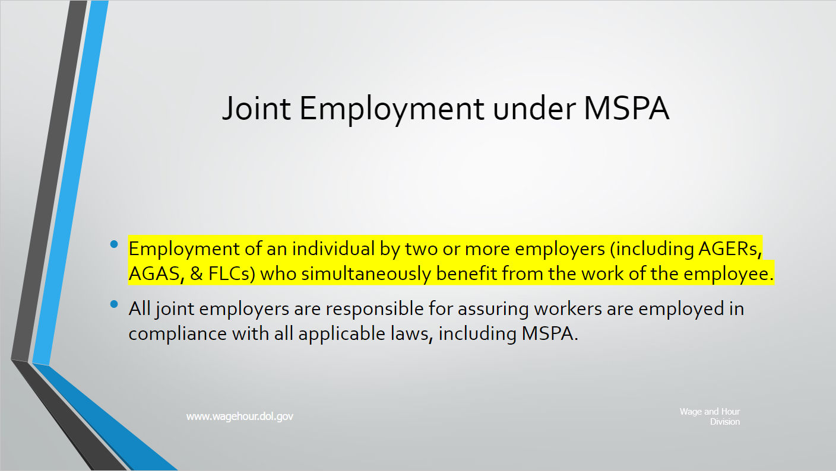
What does "joint employment" mean?
Joint employment means than an individual is employed by two or more persons at the same time.

Slide 100
How can one determine if joint employment exists?
The ultimate question is whether the agricultural work is economically dependent upon more than one person.
Where a joint employment relationship exists, each of the employers must ensure that the employee receives all employment legal rights.
Both parties may be held liable if either party fails to comply with the law.

Slide 101
Q and A
If a grower is exempt from MSPA and FLSA due to small size, but uses an FLC to find labor, is the grower still jointly liable for any MSPA/FLSA violations that could occur with that FLC?
Yes, if the combined total (Growers workers and FLC’s workers) of agricultural labor is greater than 500 man days.
Note: "Man-day" means any day during which an employee works at least one hour.

Slide 102
Best Practices
Make sure that you only use registered farm labor contractor.
  Ensure they only perform the activities they are authorized for (transporting, driving, or housing).
Due to potential joint-employment liability you may have when working with an FLC, consider verifying that the FLC’s practices meet all legal requirements.
  Terms and conditions of the job to each employee
  Accurate time and payroll records
  A pay statement to each employee
  Completed I-9 records for all workers (check ages)
Consider checking references of any FLC and any corresponding FLCE you are considering hiring.
Consider paying all workers directly to ensure accurate and timely payment of wages and taxes.

Slide 103
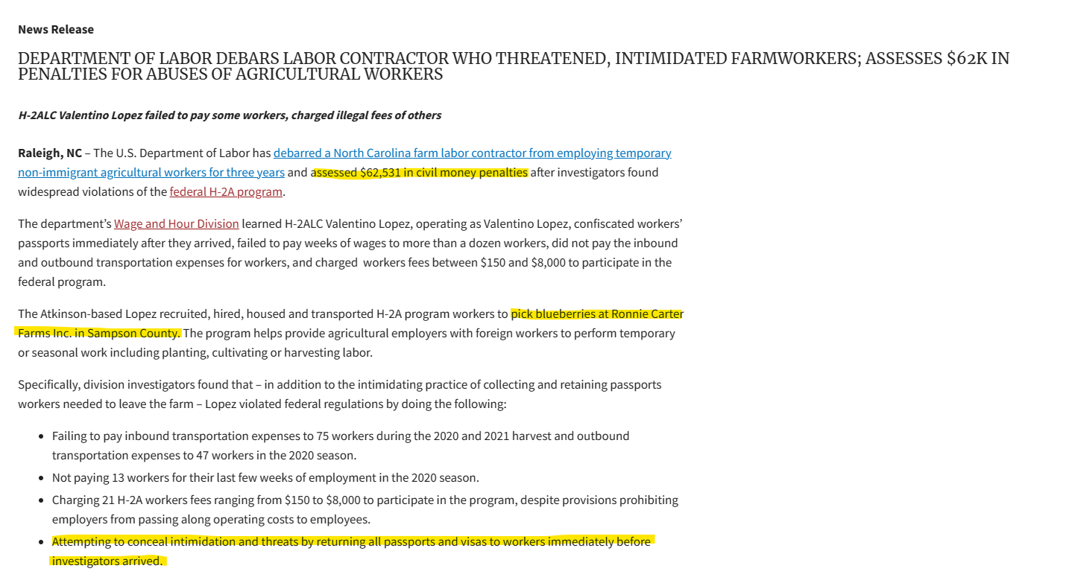

Slide 104
Blooming Onion
Human smuggling, forced labor among allegations in south Georgia federal indictment (November 22, 2021)
  54-count indictment in USA v. Patricio et al. details felony charges resulting from Operation Blooming Onion, an Organized Crime Drug Enforcement Task Forces (OCDETF) investigation.
  The multi-agency investigation, led by Homeland Security Investigations and other federal agencies, spans at least three years, and the 53-page indictment documents dozens of victims of modern-day slavery while spelling out the illegal acts that brought these exploited workers into the United States and imprisoned them under inhumane conditions as contract agricultural laborers.
  Exploitation of the workers included being required to dig onions with their bare hands, paid 20 cents for each bucket harvested, and threatened with guns and violence to keep them in line.
  The workers were held in cramped, unsanitary quarters and fenced work camps with little or no food, limited plumbing and without safe water.
  The conspirators are accused of raping, kidnapping and threatening or attempting to kill some of the workers or their families, and in many cases sold or traded the workers to other conspirators.
  At least two of the workers died as a result of workplace conditions. In the Southern District of Georgia, these activities were alleged to have taken place in the counties of Atkinson, Bacon, Coffee, Tattnall, Toombs and Ware as farmers paid the conspirators to provide contract laborers.

Slide 105
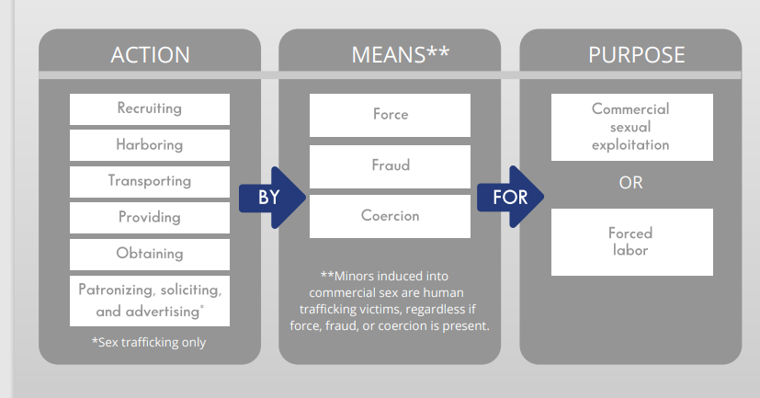
Human Trafficking
What is labor trafficking?
  The recruitment, harboring, transportation, provision, or obtaining of a person for labor or services, through the use of force, fraud, or coercion for the purpose of subjection to involuntary servitude, peonage, debt bondage, or slavery.

Slide 106
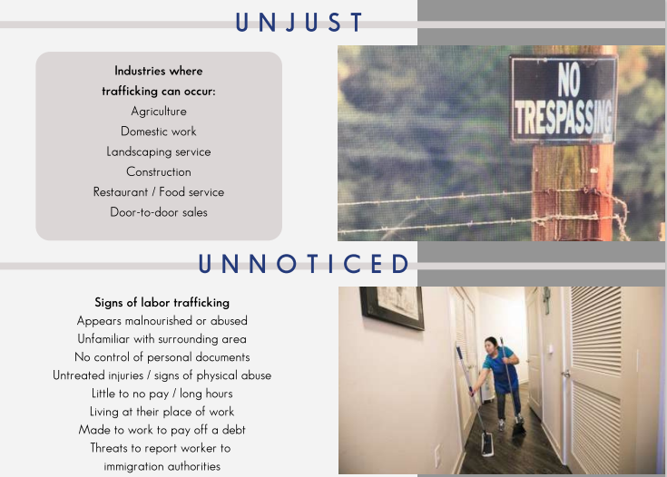

Slide 107


Slide 108
Common Challenges with Hired Labor
Jane chadwell
GAP Connections

Slide 109
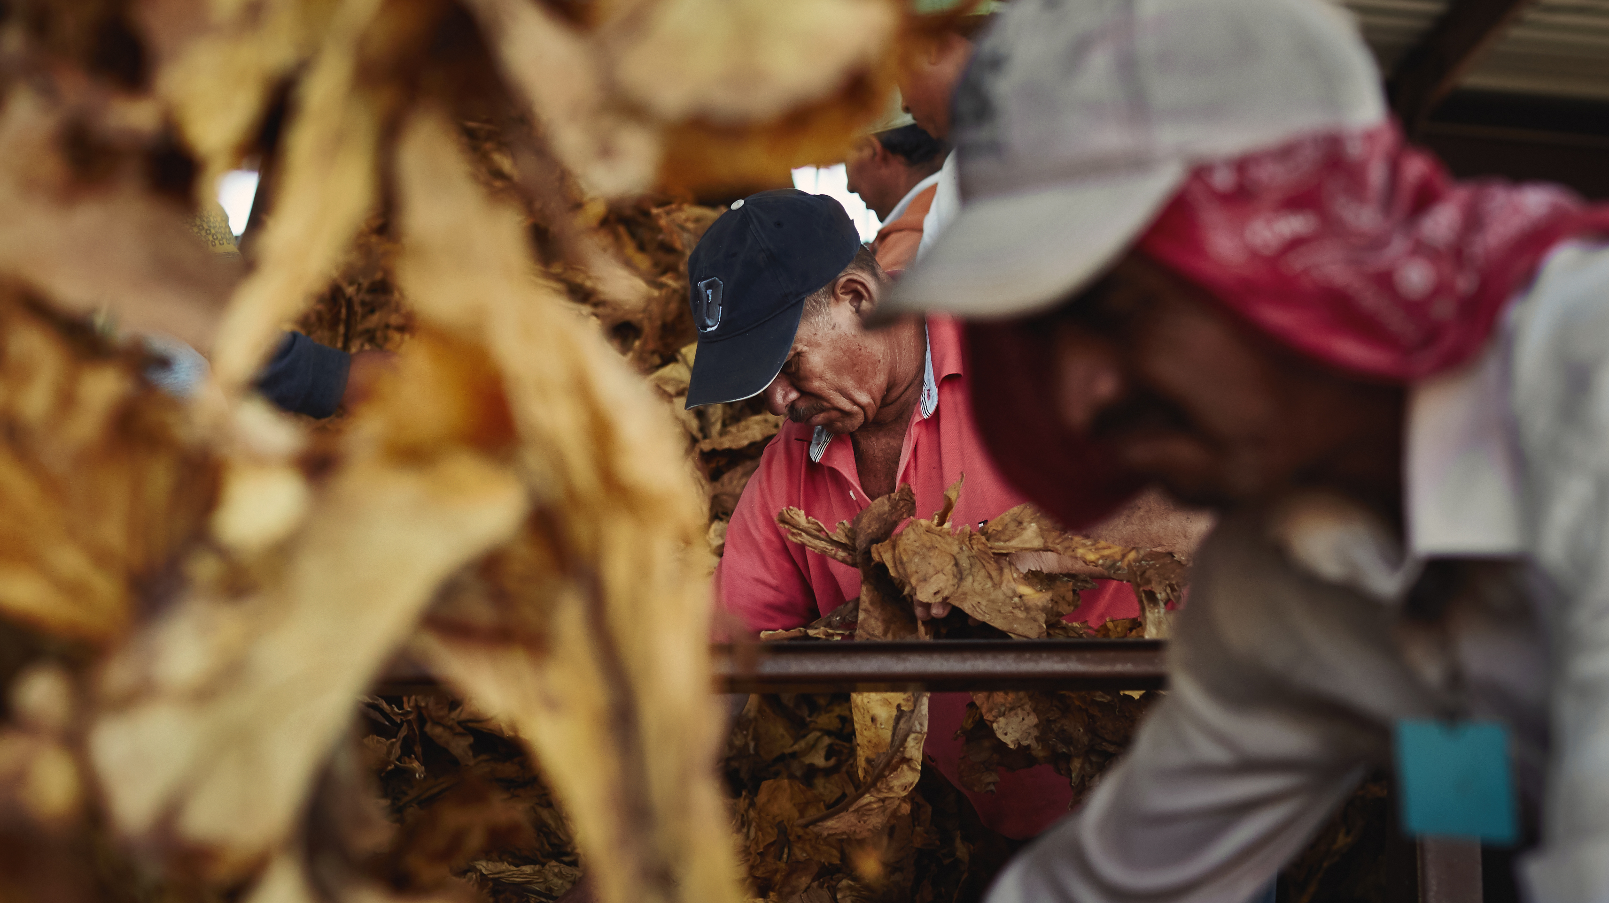
Over time the proportion of hired workers has increased, creating challenges for agricultural employers that have transitioned from readily available family labor to scarce hired labor that must be sourced and managed in compliance with complex laws.

Slide 110

Focus on the need, the finding, the cost, the hiring….but what about the managing and the communicating?
Strong labor management and leadership skills are required to run a successful agricultural operation.

Slide 111
/
Good, reliable employees can provide an employer with a positive experience and likewise, being a good employer can provide a positive experience for employees.
As in any business, both employees and employers have responsibilities to the business and to each other.
Production (gallons of milk, pounds of watermelons, bushels of corn) is the primary concern on the farm and for the employer; but there is a direct connection between the employees and production.
Employees who are content and respected will generally work hard and contribute toward the production goal, especially if they know their employer is happy with their efforts.

Slide 112

Create the Environment that Reduces the Risk

Slide 113
Create the Environment that Reduces the Risk
Decide and articulate your management policies.
Set clear expectations
  What is the job?
  How much and when are they paid?
  How are they to interact with you and each other?
  What do they do when they have a problem or an injury?
  How are you going to discipline?
Conduct training with workers to make sure they understand your policies and your expectations.
  Your role (the employer)
  Roles of any supervisors
  Where to report issues
  That you care
Directly communicate with workers frequently and consistently (daily, pay day, group meetings, housing visits, etc.)
Keep good records! Document, document.

Slide 114

Scenario
John is the Farmer; George is a supervisor
Day 1:
  John: George is going to take you out to the field show you how to harvest. There is water in the field and if you need to take a break talk to George.
  George: Let's go to the field. I am going to show you one time and then we need to move as quickly as possible to get this done.
  Workers: What is I have questions about how to harvest? What if I need to go to the bathroom? What if I start to feel sick? What if the water jug is empty?
Day 1:
  John: Hi! My name is John and I am the employer. I hired you to work on this farm to harvest strawberries. George is the field supervisor and will help with your training in the field and manage your locations in the fields. If you have any questions about the work or conditions in the field ask George. George works for me and if you have any issues with George or he does not answer your questions please come to me directly.
  John: First, we are going to go through a training so you understand the expectations on this farm, how to work safely, and understand your role on this operation....
  Workers: I feel like I can talk to John or George and I understand what I need to do.

Slide 115
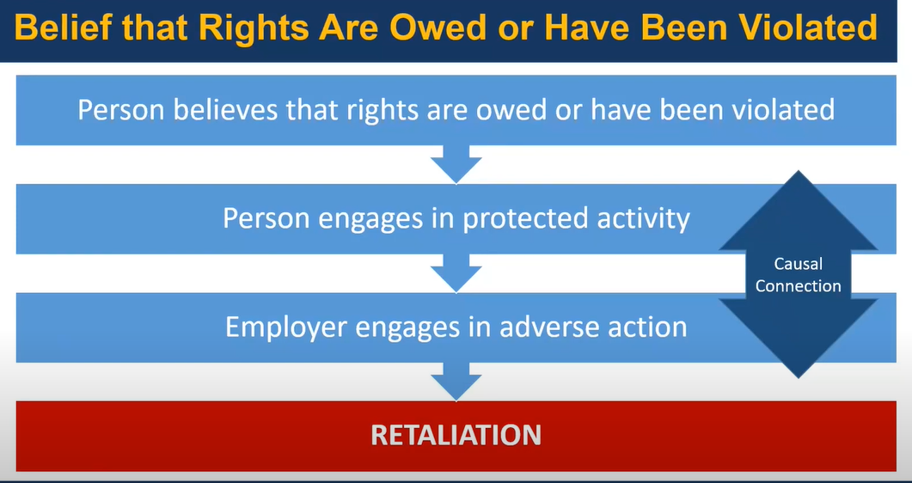
What is Retaliation?
Retaliation is when an employer, manager, or supervisor takes any type of adverse action against an employee for engaging in a protected activity.

Slide 116
MSPA & FLSA Prohibitions against Retaliation
Section 505(a) of MSPA states that it is a violation for any person to “intimidate, threaten, restrain, coerce, blacklist, discharge, or in any manner discriminate against any migrant or seasonal agricultural worker because such worker has, with just cause, filed any complaint or instituted, or caused to be instituted, any proceeding under or related to this Act, or has testified or is about to testify in any such proceedings, or because of the exercise, with just cause, by such worker on behalf of himself or others of any right or protection afforded by this Act.”
Section 15(a)(3) of the FLSA states that it is a violation for any person to “discharge or in any other manner discriminate against any employee because such employee has filed any complaint or instituted or caused to be instituted any proceeding under or related to this Act or has testified or is about to testify in any such proceeding or has served or is about to serve on an industry committee.”
Employees are protected regardless of whether the complaint is made orally or in writing. Complaints made to the Wage and Hour Division are protected, and most courts have ruled that internal complaints to an employer are also protected.

Slide 117
Adverse actions
An adverse action is an action which would dissuade a reasonable employee from raising a concern about a possible violation or engaging in other related protected activity.
Examples:
Termination or suspension,
Withholding a paycheck,
Schedule or job duty changes,
Work-related threats, warnings, or reprimands,
Blacklisting a former employee,
Making working conditions so intolerable that a reasonable person would quit,
Transfers to less desirable positions or worksites, or
Closer scrutiny of the employee’s work than of other employees without a legitimate reason.

Slide 118
Threats
If you do [ this or that ], I am going to….
“I am going to fire you”
“I am going to send you back to Mexico”
“I am going to deduct money from your wages”
“I am not going to hire you next year”

Slide 119


Slide 120

Scenario
John is the Farmer. John uses the H-2A program to hire 8 workers for his tobacco crop.
John does not speak Spanish and relies on a worker (Ray) to pass along instructions each day and to communicate with workers on behalf of grower. John never communicates directly with the workers.
The workers see Ray as a "supervisor" even though John has never communicated to any of the workers that there is a supervisor on the farm.
Workers complained to Ray that the mattress' had wires were sticking out of the bedding in the worker housing. Ray never told John because he does not want to upset John.
The workers continue to get frustrated and began making complaints about breaks, work hours and treatment of Ray to GAPC WCH, with some workers deciding to leave mid-season.
Some workers told the WCH that they had to pay Ray to get this job.

Slide 121
Responses
Option 1: John finds out about the complaints and goes to workers and says stop calling that WCH. If I find out who called, I am going to fire you. Stop complaining.
Option 2: John goes to Ray says, "Listen to what is going on?" Tells him everything and says, "Go fix this issue with the workers."
Option 3: John immediately goes into housing and determines the mattresses need to be fixed and puts in an order for new mattresses. He then conducts training with workers and a bilingual trainer covering:
  I am the boss.
  If there are issues come to speak to me directly.
  No one should be paying fees for this job. I make the hiring decisions on this farm. It is illegal to charge fees. If you have paid a fee for this job to anyone, please come see me as soon as possible so we can investigate.
  I have set-up a WhatsApp group for all workers to communicate and I am giving you my direct phone number to text or call.
  Are there any other issues I can address?
  I will be handing you your check each pay day and walking through the housing each week, if you would like to use that time to communicate with me any issues you may have.

Slide 122

Best Practices for Recordkeeping
Dawn Farias
Labor compliance consultants

Slide 123
Best Practices
Record Keeping
Communication
Training

Slide 124
Best Practices
Disclosure (MSPA & H-2A)
Record Keeping (MSPA & H-2A)
Wage Statements (MSPA & H-2A)
Hours Offered (H-2A)
Additional Employer and Contractor Records
H-2A Recruitment Records
I-9 Documentation
Communication
Training

Slide 125
MSPA Items to be Disclosed
Rates of pay (including piece rates)
Employee benefits provided, if any (including any charges)
Period of employment
Place of employment – Employer Name and Address
Crops and activities to be performed
Worker’s compensation insurance information, if applicable
Transportation arrangements, if any (including any charges)
Existence of any Strike or Work Stoppage or Slowdown
Housing Terms and Conditions

Slide 126
MSPA Disclosure
Employment conditions must be disclosed in the language of the worker and must be posted at the site of employment:
  Migrant workers must receive written disclosure at time of recruitment
  Seasonal workers must receive verbal disclosure at time of hire and must be provided written disclosure upon request.

Slide 127
H-2A Wage Contract/Job Order
Work Contract/Job Order must include all required information.
If a work contract exists it must be approved by ETA and it becomes part of the Job Order.
Each H-2A worker and worker in corresponding employment must receive a copy of the Job Order.
  H-2A worker no later than the time at which the worker applies for the visa
  Worker in corresponding employment no later than on the first day of employment.
  The contract must be in a language understood by the worker

Slide 128
Record Keeping
Records for each employee:
  ~Employee Name, Permanent Address & SSN
  ~Date of Birth for Workers Under 19 Years Old
  ~Basis Wages are Paid: Hourly, Pieces (rate of pay, piece rate)
  ~Number of Units Completed, IF Paid Piece Rate
  ~Total Hours Worked
  ~Gross Wages
  ~All Deductions and Purpose of each Deduction
  ~Net Pay

Slide 129
H-2A Record Keeping
The following payroll information must be maintained:
Starting & Stopping Times
Total Daily & Weekly Hours Worked
Number of Hours Offered, Reasons for Hours Less than Offered
Rates of Pay
Pieces, if paid Piece Rate
Gross Earnings
Deductions
Net Pay
Worker Name & Address
Worker Social Security Number

Slide 130
Common Issues with Hours Worked
Keeping Accurate Records of Hours Worked Including:
Pre- and Post-Work
Waiting Time
Travel Time
Rest and Meal Periods
Meetings and Training

Slide 131
MSPA Wage Statement
Employer must provide wage statements every payday that include:
  Name and Address of Employer
  EIN or Social Security Number of Employer
  Employee Name, Permanent Address & SSN (last 4)
  Number of Units Completed, IF Paid Piece Rate
  Total Hours Worked
  Gross Wages
  All Deductions and Purpose for each Deduction
  Net Pay

Slide 132
H-2A Wage Statement
MUST INCLUDE:
Starting & Stopping Times
Total Daily & Weekly Hours Worked
Number of Hours Offered in accordance with the Contract
Rates of Pay
Pieces Produced Daily, if paid Piece Rate
Gross Earnings
An Itemization of all Deductions made from the Worker’s Wages
Net Pay
Employer & Worker Name & Address
Worker Social Security Number (last 4)
Pay Period & Pay Date
* The statement should be in a language understood by the worker

Slide 133
H-2A Hours Offered
Contract Hours
Actual Hours Worked
Contract Hours Offered and Not Worked
Hours Offered Outside Contract Hours
Recording Reason Hours Worked Less than Offered
Contract Period Used
¾ Guarantee Computation
Have You Met the ¾ Guarantee?
Contract Impossibility Requirements

Slide 134
Additional Records
Vehicle Inspection Reports
Auto Insurance
Valid Driver’s Licenses for all Drivers
Doctor’s Certificate (WH-515)
Housing Inspection Reports
Housing Terms and Conditions

Slide 135
Contractor Records
Get a copy of valid FLC/FLCe/H-2ALC registrations (housing, transportation, driving authorized)
Get a copy of the disclosure given to workers
Get a copy of pre-occupancy housing inspections, if applicable
Get a copy of vehicle registrations, insurance and inspections, if applicable
Driver’s license & doctor certificate for all drivers, if applicable
Get a copy of contractor payroll records
Get copies of each seasons W-2s
Get proof of payment of all employment taxes

Slide 136
H-2A Recruitment Records
Records Required for H-2A Recruiting:
Positive Recruitment Documentation
Contact with U.S. Workers Employed in Previous Year
Detailed Records for Recruitment Report
Records of Contacts for Employment
  Dates, Times, Type of Contact (phone, email, walk-in)
  Hire Date
  Reason for Not Hiring

Slide 137
I-9 Documentation
Complete and retain I-9 Forms
Verify Employee Identity
Verify Employment Eligibility
Updating & Reverifying Eligibility

Slide 138
Common Record Keeping Problems
Workers not given full disclosure in writing
No record of hours worked when paid piece rate
Not all hours worked recorded or paid
Illegal deductions
Workers don’t receive complete wage statements each pay period
Not accurately recording hours offered (H-2A)
Agricultural Employers not maintaining copies of FLCs records
Not maintaining accurate, detailed recruiting documents (H-2A)
Not accurately completing and maintaining required I-9 documents

Slide 139
Communication of Policies
Disciplinary Policy
Performance Issues
No Retaliation Policy
Prohibitions Under FLSA, MSPA, H-2A
Terminations Under H-2A
Notification
Unlawful Deductions and Prohibited Fees

Slide 140
Training
Ensure Managers are Trained on Policies & Procedures
Ensure Workers are Trained on Policies & Procedures
Train Employees to Keep Accurate Time Records
Ensure Contractors Comply with Policies & Procedures
Ensure All Employees Know They Cannot Request, Accept or Pay Unlawful Fees
Make Sure Workers Know Who to Contact?

Slide 141
Compliance Assistance Materials
29 C.F.R. Part 516 FLSA Record Keeping
Migrant and Seasonal Agricultural Workers Protection Act (MSPA)
29 C.F.R. Part 500
Fact Sheet #49 MSPA
WH-516 Terms and Conditions MSPA
WH-501 Wage Statement MSPA
Immigration Nationality Act
The Regulations (29 CFR Part 655)
Fact Sheet No. 26 Section H-2A of the INA
Fact Sheet No. 26B Disclosure of the Job Order
Fact Sheet No. 26C Records Retention
Fact Sheet No. 26E Job Hours

Slide 142
Questions?
Dawn M. Farias
Labor Compliance Consultants
Dawn@LaborComplianceConsultants.com
(423)343-8877

Slide 143
Disclaimer
This presentation is intended as general information only and does not carry the force of legal opinion.
Labor Compliance Consultants is providing this information as a service. This information and related materials are presented to provide access to information on Department of Labor programs. You should be aware that, while we try to keep the information timely and accurate, there will often be a delay between official publications of the materials and the modification of these pages. Therefore, we make no express or implied guarantees. The Federal Register and the Code of Federal Regulations remain the official source for regulatory information published by the Department of Labor. We will make every effort to keep this information current and to correct errors brought to our attention.

Slide 144
Best Practices for Communication, Policies, and Safety Training
Amy rochkes
GAP Connections

Slide 145

Effective Communication
Strong employer-employee relations in agriculture are built on a foundation of trust and collaboration.
When employers prioritize open communication, respect, and mutual understanding, it creates an environment where employees feel valued and increase productivity.
Ensure you are doing all you can to stay compliant.

Slide 146

Communication with Workers
Create a working environment where employees are comfortable voicing concerns without negative reaction or retaliation
Regular communication is always the Best Practice
Consider daily or weekly meetings with employees
    Show verbal gratitude “Say Thanks”
    Here is the work plan for the day or week
    Talk about job improvement
    Ask “Do you have questions or concerns?”
Being kind and respectful “The Golden Rule”

Slide 147

Employee Orientation & Onboarding
Complete required paperwork
  Form I-9
  Social Security Number Application
  W-2 Tax Form
Review and Provide Workers Information on:
  Terms & Conditions of Employment
  Understanding Wage Statements
  Anti-discrimination Policy
  Disciplinary Policy
  No Retaliation Policy
  Farm Emergency Plan
  Housing Occupancy Terms & Conditions
  Housing Rules & Expectations
  Transportation Rules & Expectations

Slide 148

Disciplinary Policy
Have a written Disciplinary Policy which includes steps:
  Verbal warning
  Corrective Action(s)
  Counseling
  Official Written Reprimand
  Disciplinary meeting
  Final Written Warning
  Suspension
  Termination
Review and Provide Workers with a Copy of the policy
Use the same policy for all employees
Each employee should be treated the same to avoid claims of discrimination or retaliation

Slide 149

Document, Document, Document
When there is evidence or suspicion of misconduct, the employer should investigate the matter and document the findings
The nature of the events must be explained to the employee
Document every step of the disciplinary process including the employee's response and steps towards improvement
The employee should read and sign the written reprimand and final written warning
The documents should include the time frame in which an employee must correct their conduct

Slide 150

Performance Issues
Employee Misconduct
Fighting
Harassment or Bullying
Drug or Alcohol use
Attendance Issues
Inadequate Performance

Slide 151

Retaliation
Retaliation is defined as any kind of negative action against a current or former employee that takes the form of punishment or creates a hostile, threatening, or uncomfortable environment because of their report
Retaliation can be expressed in a variety of ways:
  Harassment
  Termination
  Reduction of pay hours or benefits
  Exclusion

Slide 152

Retaliation Policy
Create a Retaliation Policy to ensure Disciplinary Policies are not used in a retaliatory manner
Make sure employees know how to communicate problems to you and they do not need to fear reprisal
Employees have the right to communicate problems, suggestions, or issues
Employees that file complaints with an employer or a government agency are protected under federal law
It is to the employers benefit to resolve issues as soon as they come up to avoid retaliatory behavior

Slide 153

Addressing worker issues and concerns…
If a worker does something on the farm…
  Provide the proper discipline
  Make sure the worker understands disciplinary measures (language barrier)
  Provide corrective action as described in Terms of Employment and Disciplinary Policy
If a worker expresses a concern to you DON’T:
  Threaten
  Intimidate
  Retaliate

Slide 154

Termination of Employees
Employer may terminate an employee
Terminate for Cause:
  Unable, Unwilling, or Unqualified for the job listed in the work contract
  Refusal to work
  Serious Act of Misconduct
  Lawful job-related reason

Slide 155

Abandonment
Failure to report for work for 5 consecutive working days without consent of the employer
The employer has 2 days from the abandonment or termination to complete notifications
  Employers are required to notify the Department of Labor and in the case of an H-2A worker the Department of Homeland Security

Slide 156

Best Practices for Housing
Communicate the rules and expectations
  If you have specific disciplinary actions explain to the employees
  Review important safety items, important rules that help keep everyone safe in the housing
  Examples of rules:
    Dishes washed & kitchen cleaned daily
    Dispose trash daily – Keep lid on trash can
    Set quiet hours in housing
Post a housing checklist
Walk through housing weekly to check for maintenance and cleanliness
Ask employees about housing
Consider a comment box for anonymous reporting issues or concerns
Notes:
You can have rules for housing & transportation

Slide 157

Annual Safety Training
General Farm Safety
Safe Operation of Farm Equipment & Machinery
Heat Stress – Symptoms and Treatments
Farm Emergency Plan and Emergency Responses
Basic First Aid
Location & Use of Fire Extinguishers
Personal Protective Equipment (PPE)
  Location
  Proper use
Worker Protections Standard Training
  Storage, Handling, Application, and Disposal of Agrichemicals
  Use of PPE

Slide 158
Best Practices for Employer Provided Housing
  Lance Butler, TN Department of Labor & Workforce Development

Slide 159

Housing Inspections
Regulations
Tennessee Department of Labor and Workforce Development
Presented by: Lance Butler
State Monitor Advocate

Slide 160
Regulations
ETA
Employment & Training Administration
Housing built before April 3, 1980
OSHA
Occupational Safety and Health Administration
Housing built on April 3, 1980 to present or remodels

Slide 161
Housing Regulations
ETA
Housing Site 654-404
  Complete a thorough walk around the perimeter of the grounds.
  Well drained and free of depressions
OSHA
  Same as ETA, but in addition:
    (a)(1) stagnating pools, sink holes or other surface collections of water must be at least 200 ft. away from housing units
    (a)(2)Housing units adequately spaced apart
    (a)(2)Housing is located at least 500 ft. from any livestock
    (a)(3) Free of rubbish, waste and other refuse
    (a)(4) Whenever camp is closed for season all trash and other refuse must be removed

Slide 162
Housing Regulations
ETA
Water Supply 654.405
  A minimum of 35 gallons of water per occupant per day
  A water test must be completed if the housing unit is not on city water
  Hot water supply Gallons Per Hour (GPH) recovery is:
    2.652 X No. of persons = ____GPH (ex. 2.652*10 persons=26.52)
  Hot water storage (Tank Capacity)
    3.28 X No. of persons = ____ Gallons Tank Capacity Required(ex. 3.28*10=32.8)
OSHA
Water Supply 1910.142 (c)
  (c) (1) Approved by appropriate health authority if on well water.
  (c) (2) Supply 35 gallons per person per day
  (c) (3) Water lines capable of supplying water at normal pressure simultaneously to all fixtures
  (c) (4) One drinking fountain for each 100 occupant (no common drinking cups)
Hand Washing 1910.142 (f)
  Adequate supply of hot and cold water under pressure
    Facilities for heating water provided
Shelter 1910.142 (b)
  (b) (11) Heating, cooking, and water heating equipment installed in accordance with State and local ordinances – camps used in cold weather shall have adequate heating equipment

Slide 163
Housing Regulations
ETA
Excreta and Liquid Waste Disposal 654.406
  City Sewer when possible
If Septic Tank is used
  No visible discharge, smell, or ground accumulation
OSHA
Sewage Disposal Facilities 1910.142 (e)
  Same as ETA
Site 1910.142 (a)
  (a) (3) Free of rubbish, waste and other refuge
  (a) (4) Whenever camp is closed for season all trash and other refuse must be removed

Slide 164
Housing Regulations
ETA
Housing 654.407
  Structurally Sound
  Adequate hanging storage per occupant
  Floors rigid, smooth, readily cleanable
  Floor space adequate
    Single bed – sleeping only – 50 sq. ft. per occupant
    Bunk bed– sleeping only – (80 sq. ft.) 40 sq. ft. per occupant
    Cooking, eating, sleeping– 60 sq. ft. per occupant
OSHA
Shelter 1910.142 (b)
  (b)(1) House constructed in a manner which will provide protection against the elements
  (b)(2) Beds – 50 Sq. Ft. per occupant in rooms used for sleeping only and a 7’ ceiling
  (b) (4) & (5) Floors – Same as ETA
  (b)(9) In rooms where workers cook, live, and sleep, a minimum of 100 Sq. Ft. per occupant

Slide 165
Housing Regulations
ETA
Screening 654.408
  Window Space & Screening
  Should equal to 10% of usable floor space
  45% of window opens
  Adequate skylight
  Air conditioning system okay
  16 inch mesh screen
  Screen doors shall be self closing fly tight
OSHA
Shelter 1910.142 (b)
  (b)(7) Windows – Same as ETA but must open to 50%
  (b)(8) Mesh & Self closing doors – Same as ETA

Slide 166
Housing Regulations
ETA
Heating 654.409
  Each habitable room equipped with properly installed heating mechanism(space heater, wall heater)
  Minimum 68°
  Wood burning stoves/Fireplace with must be properly installed vented and fireproof
  Stove pipe constructed of fireproof materials
  Well ventilated metal collar around stove pipe
OSHA
Shelter 1910.142 (b)
  (b)(11) Heating, cooking, and water heating equipment installed in accordance with State and local ordinances – camps used in cold weather shall have adequate heating
  (4) Heating provided during cold weather capable of maintaining at least 70 degrees F

Slide 167
Housing Regulations
ETA
Electricity & Lighting 654.410
  Must be lighting fixtures in each habitable room
  Lighting in laundry rooms, hallways, stairwells, yard
  At least one wall outlet in each room
  Wiring in safe condition
  No exposed wiring
OSHA
Lighting 1910.142 (g)
  Each habitable room must have at least one ceiling type light fixture and one wall type outlet
  Rooms where people congregate i.e. Laundry , Livingroom & bathroom must have at least one ceiling or wall type light fixture

Slide 168
Housing Regulations
ETA
Toilets 654.411
  One water closet(flushing toilet), or privy(outhouse), per 15 occupants
  If urinals are used, must be properly constructed
  Separate toilet accommodations for men and women, unless family unit
  Toilet tissue must be furnished by employer
  Clean and sanitary
  If separate toilet building, then must be within 200 feet of housing unit
  If privy present, cannot be closer than 50 ft. from living unit or food facilities
  Privy must be fly tight
  Privy must meet state and local code
OSHA
Toilet Facilities 1910.142 (d)
  (d) (2) Window opening directly to outside with 16-mesh or adequate ventilation
  (d) (3) toilet within 200 ft. and not closer than 100 ft. to any dining, sleeping or kitchen
  (d) (4) in co-ed facilities, toilets must be marked for separate sexes
  (d) (5) One toilet per 15 occupants with minimum of two toilets in a shared facility
  (d) (6) If urinals are used, 1 urinal per 25 men and constructed of approved materials
  (d) (7) After 8/1971 every water closet(toilet) must have its own room
  (d) (8) must be lighted naturally or artificially at all hours day or night
  (d) (9) Toilet paper supplied
  (d) (10) Kept in sanitary condition – cleaned at least daily

Slide 169
Housing Regulations
ETA
Bathing, laundry, hand washing, Showers 654.412
  Hot and cold water under pressure
  Clean and sanitary
  Within 200 ft. of living unit
  One shower head per 15 occupants
  Dry dressing space
  If multiple shower heads present, must be 3 ft. apart & a minimum of 9 sq. ft. floor space per shower head
  Showers have proper drains
  Separate shower facilities for each sex except in family unit
  One sink for each 15 occupants
  Supplied with hot and cold water under pressure
  One tub/tray per 25 persons or
  One mechanical washer per 50 persons
  With minimum of one tub per 100 persons
  Clothes line or mechanical clothes dryer
OSHA
Laundry, hand washing, & bathing facilities 1910.142 (f)
  (1) Ratio:
    (i) 1 (one) basin (sink)for each family or for 6 (six) occupants
    (ii) 1 (one) shower head per 10 occupants
    (iii) 1 (one) laundry tray/tub for every 30 occupants
  (2) Floors: smooth but not slippery
    Floor drains
    Walls smooth and impervious to water
  (5) Facilities to dry clothes shall be provided
  (6) All service building shall be kept clean

Slide 170
Housing Regulations
ETA
Cooking & Eating Facilities 654.413
Space provided for cooking & eating in individual units
One stove or at least 2 burners per 10 occupants
Counter for food preparation & adequate food storage shelves/cabinets
Mechanical refrigerator maximum temperature 45°
Table and chairs equivalent seating and eating arrangements per number of occupants
Adequate lighting and ventilation
Adequate sink with hot and cold water under pressure
Floors of non-absorbent easy to clean material
Wall adjacent to stove easily cleaned, fire resistant
OSHA
Shelter 1910.142 (b)
(b) (10) One stove per 10 occupants – sanitary facilities for storing and preparing food
(b) (11) Heating, cooking, and water heating equipment installed in accordance with State and local ordinances – camps used in cold weather shall have adequate heating equipment
Kitchens, dining hall, and feeding facilities 1910.142 (i)
(1) in all camps where central dining or multiple family feeding operations are permitted, must comply with requirements of the “Food Service Sanitation Ordinance and Code.”
(2) Kitchen and dining hall adequate in size, separate from sleeping quarters, there shall be no direct opening from living or sleeping quarters into kitchen or dining hall
(3) No person with any communicable disease shall be employed or permitted to work in the preparation, cooking, serving, or handling of food

Slide 171
Housing Regulations
ETA
Garbage & other refuse 654.414
Fly tight 20 gallon container
  At least 1 for each 15 occupants
  Collected at least 2 times per week
  Disposal in accordance to state code
Insect & Rodent Control 654.415
Free of insects, rodents, or other vermin
  Check for evidence of infestation
OSHA
Refuse Disposal 1910.142 (h)
(1) Fly-tight, rodent-tight container approved by the appropriate health authority
  Shall be located within 100 feet of each shelter
(2) Must be kept clean
(3) Shall be emptied when full but no less than 2 times per week
Insect & Rodent Control 1910.142 (j)
Effective measures shall be taken to prevent infestation

Slide 172
Housing Regulations
ETA
Sleeping Facilities 654.416
Comfortable beds
Clean mattress & covers
Beds at least 30 inches apart from each other, end to end or side by side
Bedding Clean and sanitary
Double beds for family only
No triple bunks
Bunk beds must meet clearance
  27 inches from top of bottom mattress to bottom of top bunk
  36 inches from top of top mattress to ceiling
OSHA
Shelter 1910.142 (b)(3)
Clean mattresses and suitable storage for personal articles in each room used for sleeping
  Beds at least 36 inches apart from each other
  Beds elevated 12 inches off the floor
  Bunks must be 48 inches apart from each other
  Bunk clearance same as ETA

Slide 173
Housing Regulations
ETA
Fire, Safety, & First Aid 654.417
Building constructed & maintained in conformity to State and local fire safety laws
Two means of escape provided
  Open window of at least 24”X24” (58 sqft)may be used as second means of escape of less than 10 people and in 1 story construction only
  For more than 10 people, two doors for escape.
  Second story sleeping quarters & common room have stairway & a permanently affixed exterior ladder or a second stairway
    Complies with local fire codes
ETA Cont.
Fire extinguisher provided & readily accessible
  2 ½ gallon stored pressure
  Within 100’ from each housing unit
  ABC code for all fires
First aid facilities to include 16 unit first aid kit at a ratio of 1 for 50 occupants
No flammable or volatile liquids stored adjacent to rooms
No agricultural pesticides and toxic chemicals stored in housing area

Slide 174
Housing Regulations
OSHA
First Aid 1910.142 (k)
(1) Adequate first aid facilities – same as ETA
(2) Such facilities shall be made accessible for use at all times
Reporting Communicable Disease 1910.142 (l)
  (1) The camp superintendent must report immediately to the local health authority the names of occupants known to have or suspected of having a communicable disease
    (2) If a camp has a suspected case of food poisoning or unusual prevalence of any illness including fever, diarrhea, sore throat, vomiting, or jaundice symptoms, it shall be immediately reported to the local health authority

Slide 175
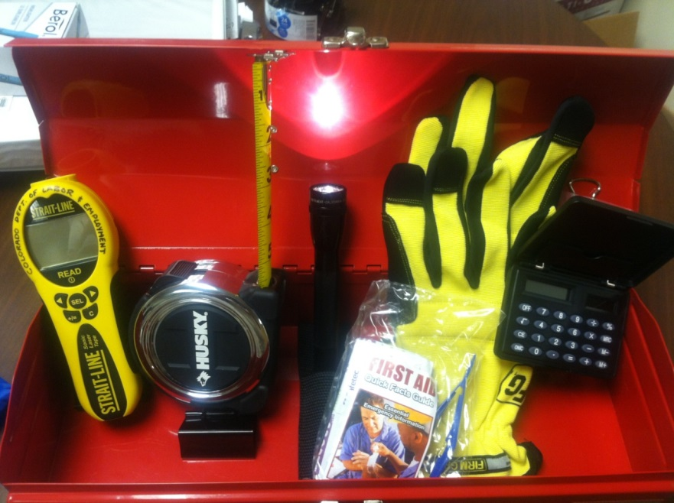
Tool Box
Laser Measure
Tape Measure
Flashlight
Gloves-Disposable
Calculator
First Aid Kit
Pen/Pencil
Camera/phone

Slide 176
Thank You

Slide 177
Workplace Injuries and Workers Compensation Considerations
Jeff Francis, Assistant Administrator
TN Bureau of Workers' compensation

Slide 178
WC 101
Best Practices for the Agriculture Industry
Jeff Francis, Assistant Administrator, Tennessee Bureau of Workers’ Compensation

Slide 179
What is
Workers’ Compensation?

Slide 180


Workers’ Compensation
An insurance program that provides:
Medical Benefits Wage Replacement Benefits
to workers who are injured or become ill as a direct result of their job

Slide 181
Purpose
What is the
main purpose of
Workers’ Compensation?

Slide 182

Purpose of Workers’ Compensation
It’s to help injured employees:
  Return to their health
  Return to their jobs
As quickly as possible.

Slide 183

Workers’ Comp in the US is a state-mandated and regulated system.
States have differences in their:
  Coverage requirements
  Eligibility for benefits
  Type and Amount of benefits
  Penalties for not complying
  This presentation covers only Tennessee claims.

Slide 184
During This Presentation:
I am going to introduce you to some practical ideas to help:
  Understand Tennessee’s system
  Make the process FAIR for everyone whenever someone gets hurt at work.

Slide 185

Both sides have rights
Employees have a right to the medical and
wage replacement benefits in the law if their work causes their injury.

Slide 186

Employee Rights
An employee has a right to report an injury or illness he/she suspects was caused by work.

Slide 187
Both sides have rights
Employers have a right to control certain aspects of the claim.

Slide 188
Employer Rights
An employer has a right to expect that report to be provided immediately.
But what does immediately mean?
15 calendar days of when they:
  know or
  should have known

Slide 189
Employer Rights
So, what happens if an employee waits until the 16th day, 30th day or even later?
Can you say:
“Too bad!! So sad!!”
No!
  Unless you want to risk a penalty!

Slide 190
Employer Rights
So, what if you think your employee is lying?
Can you say:
“Liar, Liar. Pants on Fire!
Now, go back to work or go home!”
No!
Unless you want to risk a penalty!

Slide 191

You don’t have the right to deny a claim
An Adjuster is required to investigate the claim and accept or deny it…
…with assistance from you.

Slide 192

To protect your rights…
…Assist the adjuster by having the employee provide a written statement of events when they report their injury.

Slide 193

Medical Care
Loading your injured employees in your car and taking them to the doctor you choose is frowned upon!

Slide 194
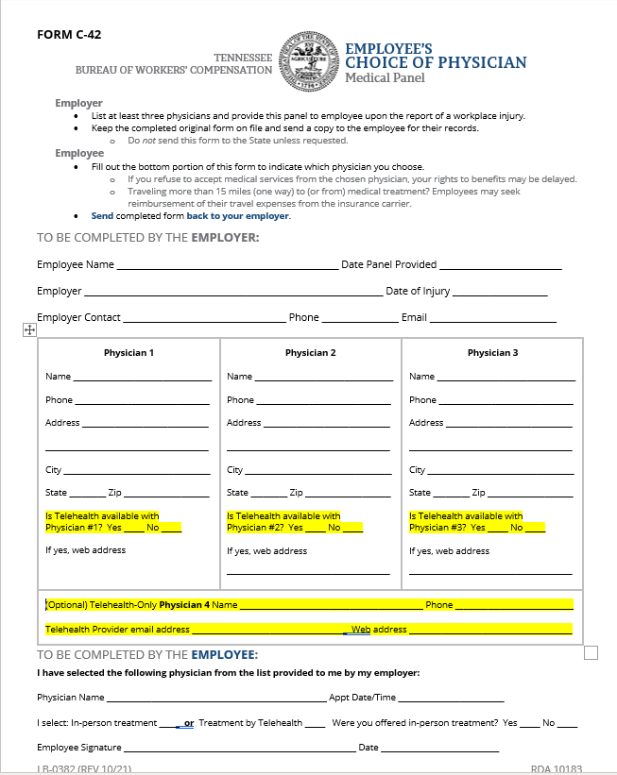
Employer Rights
Employers have the right to limit which doctors treat injured employees for their workplace injuries.
But how is that done?
By providing a panel of physicians
Choice of Physician Form C-42

Slide 195

Creating the panel
HOW MANY?
WHERE?
WHO?
Within the community of the injured employee--not of the worksite.
Can go out as far as
125 miles if necessary.
At least three physicians.
Can list
walk-in clinics if it lists the name of their supervising MD/DO next to the clinic's name
Physicians of the appropriate specialty.
No longer required to include a chiropractor.
Don't have one on the breakroom wall.

Slide 196
Who pays workers’ comp benefits?
  Not us!!
  Not you!!
  It’s your company’s workers’ comp insurance carrier.

Slide 197
Medical Benefits In Workers’ Compensation
Free of charge if:
  Reasonably necessary and
  Ordered by the attending physician.
For the rest of their life if the need is related to the work injury.

Slide 198
Wage Replacement Benefits
Temporary Disability Benefits
Temporary Total Disability Benefits
  66 2/3^{rds} % of the employee’s AWW
Temporary Partial Disability Benefits
  66 2/3^{rds} % of the difference between pre- vs post-injury average weekly wage

Slide 199
Wage Replacement Benefits
First day of eligibility is the 8th day of disability.
  1st day of disability is the day after the date of the injury
  All 7 days count – not just scheduled workdays
  If someone misses 14 days or more, they are paid for the seven days mentioned above.

Slide 200

There is no doubt…your injured employees will have questions
The only question is where will they seek advice?
Spouse
Friends and Neighbors
Co-workers
That lawyer that advertises on TV

Slide 201

What are an employer’s responsibilities after an injury?
Accept the report of injury and help your employee:
  Know what to expect
  Know what they are entitled to
  Set expectations—recovery and return to work
Give them a copy of the “Beginner’s Guide”

Slide 202
The Ombudsman Program
Will provide education and assistance to any party who is not represented by an attorney.
An Ombudsman cannot provide legal advice.
Acts as a liaison with the parties to help open lines of communication and increase the efficiency in the administration of claims.

Slide 203
A brief recap
Six important steps to take when someone reports an injury:
Provide a panel of physicians on the proper form
Provide a copy of the Beginner’s Guide to Tennessee Workers’ Compensation & Ombudsman’s Phone #
Have the injured employee provide you with a written statement

Slide 204
6 Steps to take (continued)
After someone reports an injury:
Notify your insurance adjuster
Start your investigation if you have doubts or concerns
Work to eliminate the possibility of someone else being injured

Slide 205

One basic employer responsibility—
Have a safe worksite
Work with your employees to eliminate potential injuries—before they occur
  Create a culture of safety
  Preach “Safety first”

Slide 206
Bureau of Workers’ Compensation Offices
1-800-332-2667
www.tn.gov/workerscomp
Stewart
Montgomery
Robertson
Sumner
Macon
Clay
Pickett
Scott
Claiborne
Hancock
Sullivan
Johnson
Lake
Obion
Trousdale
Jackson
Overton
Fentress
Campbell
Hawkins
Weakley
Henry
Cheatham
Grainger
Washington
Houston
Dickson
Davidson
Wilson
Smith
Morgan
Union
Hamblen
Greene
Carter
Dyer
Gibson
Carroll
Benton
Putnam
Anderson
Unicoi
Humphreys
De Kalb
White
Cumberland
Knox
Jefferson
Cocke
Williamson
Rutherford
Roane
Lauderdale
Crockett
Henderson
Hickman
Cannon
Warren
Van Buren
Loudon
Blount
Sevier
Perry
Haywood
Madison
Decatur
Maury
Bledsoe
Rhea
Tipton
Lewis
Bedford
Coffee
Meigs
Monroe
Shelby
Chester
Marshall
Sequatchie
McMinn
Hardeman
Hardin
Wayne
Giles
Moore
Grundy
Fayette
McNairy
Lawrence
Lincoln
Fayetteville
Franklin
Marion
Hamilton
Bradley
Polk
Memphis
One Commerce Square
40 South Main St, Ste 500
Memphis, TN 38103-1820
Telephone: 901-543-6077
Fax: 901-543-6039
Nashville
220 French Landing Dr..
Nashville, TN 37228
Telephone: 615-741-1383
Fax: 615-253-2480
Cookeville
PO Box 678
Cookeville, TN 38503
Telephone: 931-520-4290
Fax: 931-520-4316
Knoxville
520 Summit Hill, Suite 103
Knoxville, TN 37902
Telephone: 865-594-5177
Fax: 865-594-5172
Jackson
225 Dr. MLK Drive, 1st Fl
Jackson, TN 38301-6985
Telephone: 731-423-5646
Fax: 731-265-7022
Murfreesboro
845 Esther Lane
Murfreesboro, TN 37219
Telephone: 615-848-6743
Fax: 615-217-9378
Chattanooga
1301 Riverfront Pkwy
Suite 202
Chattanooga, TN 37402
Telephone: 423-634-6422
Fax: 423-634-3115
Gray
5788 Bobby Hicks Highway
Gray, TN 37615-3190
Telephone: 423-854-5160
Fax: 423-239-7844
Notes:
Administrator

Slide 207
The Bureau is Here to Help You!
Assistance to help everyone understand the process
Emphasis on resolving disputes in mediation
Improved medical treatment
  Fewer delays
  Quicker return to pre-injury jobs
Faster delivery of benefits and faster access to court

Slide 208

www.tn.gov/workerscomp

Slide 209
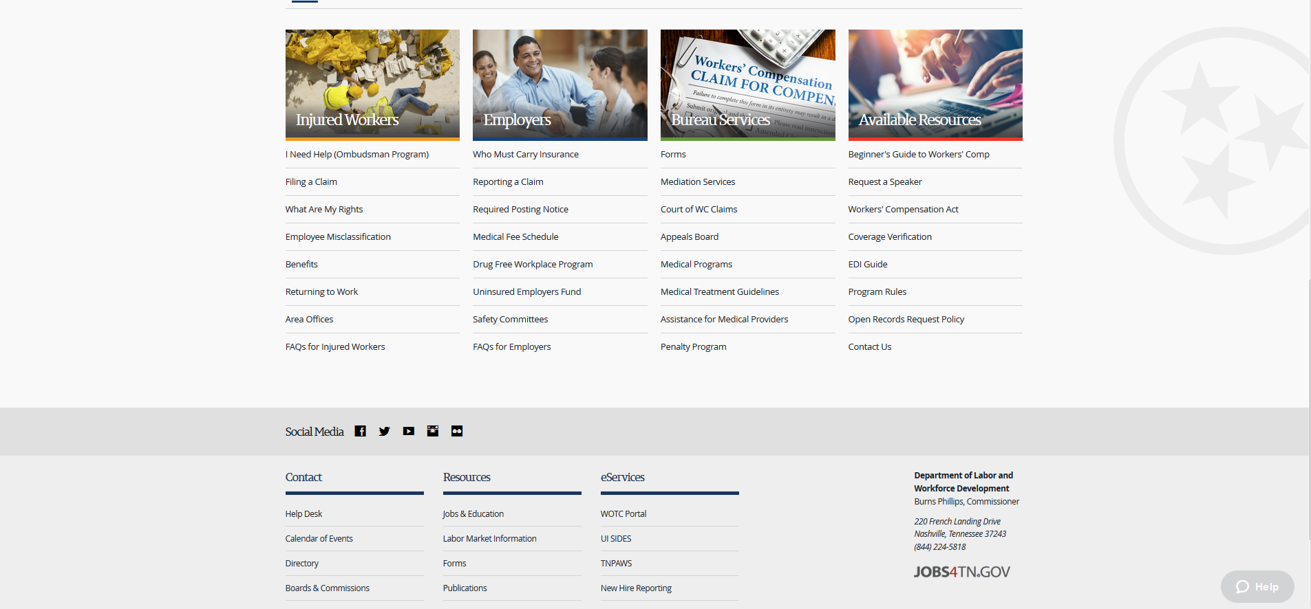

Slide 210


Slide 211

Your presenter
Jeff Francis
Assistant Administrator
Tennessee Bureau of Workers’ Compensation
b.jeff.francis@tn.gov
615-253-6269

Slide 212


Slide 213


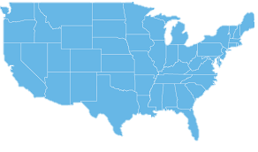
About us
Non-profit Agricultural Organization (501 c 5)
GAP Connections provides leadership for the adoption of agricultural standards and practices which produce a quality crop while protecting, sustaining or enhancing the environment, ensure the safety and rights of farm laborers, and recognize those producers who are committed to a higher standard.
Knoxville, TN
Governed by a Board of Directors
Established in 2013

Slide 214





Meet the Team
JANE CHADWELL
LAUREN WALKER
AMY ROCHKES
KATELYN WHITE
FRANCISCA RIOS
Executive Director & President
Certification & Assessment Director
Training & Resource Coordinator
Business Manager & Certification Coordinator
Farmworker Training & Program Coordinator

Slide 215


Slide 216

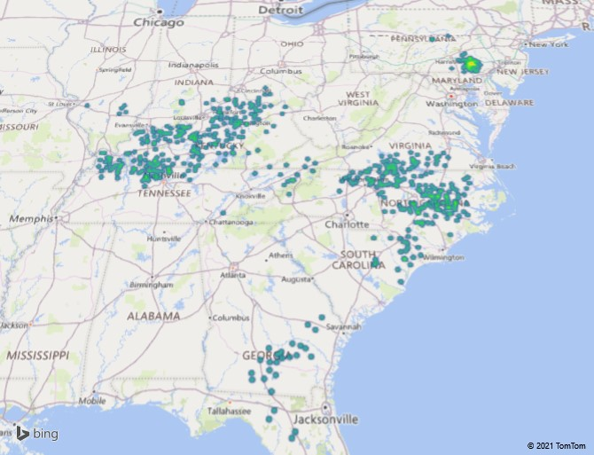



2022
1,507 Monitoring Visits conducted.
1,610 Worker Interviews completed.
2,165 GAPC Certified Grower Members on 1,478 Operations in 11 States.
162,764 Tobacco Acres and 290 Hemp Acres grown by a GAPC Certified Grower.
16,514 Farm Workers on operations managed by a GAPC Certified Grower.

Slide 217

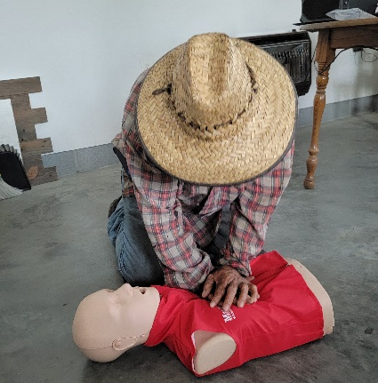
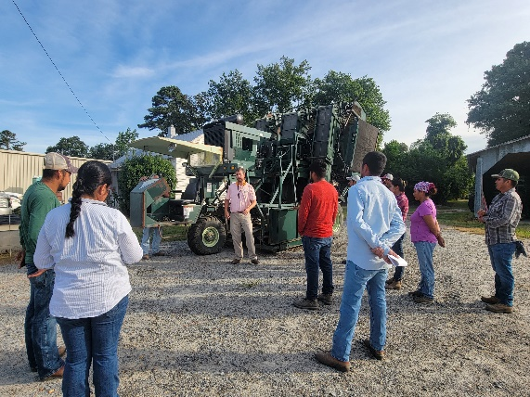
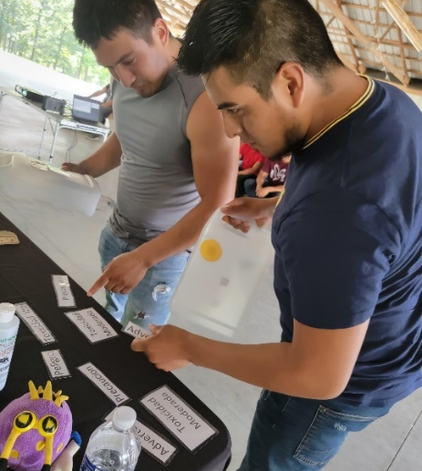
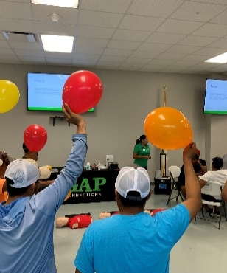

In 2023, GAPC trained 778 individuals with bi-lingual trainers through the GAPC Customized Farmworker Training program in North Carolina, Tennessee, Kentucky, Georgia, and Virginia.
Fun, interactive, educational, and appreciated.
https://www.gapconnections.com/what-we-do/customized-farmworker-training

